Slide 1


Course – Theoretical Foundations of Computations
Course Instructor
Dr. Umadevi V
Department of CSE, BMSCE
Webpage:https://sites.google.com/site/drvumadevi/

Slide 2
Unit-2
Regular Expressions and Languages
Regular Expressions, Finite Automata and Regular Expressions, Applications of Regular Expressions, Proving Languages Not to Be Regular, Closure Properties of Regular Languages, Equivalence and Minimization of Automata

Slide 3
Some Applications of Regular Languages
Efficient string searching
Pattern matching with regular expressions (example: Unix grep utility)
Lexical analysis (scanning, tokenizing) in a compiler

Slide 4
Regular Expressions (RE) and Regular languages (RL)
- Languages accepted by DFA/NFA/ε-NFA are called Regular Languages.
- Regular Expressions are used to describe Regular languages.
Operators of Regular Expressions (RE)
Name | Symbol
Union | +
Concatenation | .
Closure | *

Slide 5
Operators of Regular Expressions (RE)
Union + U
Example:
L ={001, 10, 111} M= { ε , 001}
L U M or L+M = { ε , 001, 10, 111}
L U M or L+M is a set of all strings that are either in L or M or both.

Slide 6
Operators of Regular Expressions (RE)
2. Concatenation .
Example:
L ={001, 10, 111} M= { ε , 001}
L .M or LM = {001, 10, 111, 001001, 10001, 111001}
L .M or LM is a set of all strings that are formed by taking any string in L and concatenating it with any string in M.

Slide 7
Operators of Regular Expressions (RE)
3. Star / KleeneClosure *
L* represents set of those strings that can be formed by taking any number of strings from L, possibly with repetitions and concatenate all of them.
L* is infinite union of L^{i} , i>=0
Example: L = {0, 11}
Where L⁰ ={ε} ; L¹ = {0,11} ; L^{i} , i>1, LLL…L (Concatenate L i times)
L⁰ = {ε}
L¹ = {0,11}
L² = {00, 011, 110, 1111}
L³ =L.L² = {000,0011,0110, 01111, 1100,11011, 11110, 111111}
L* = L⁰ U L¹ U L² U L³ ………
Each of them is finite, but union is infinite

Slide 8
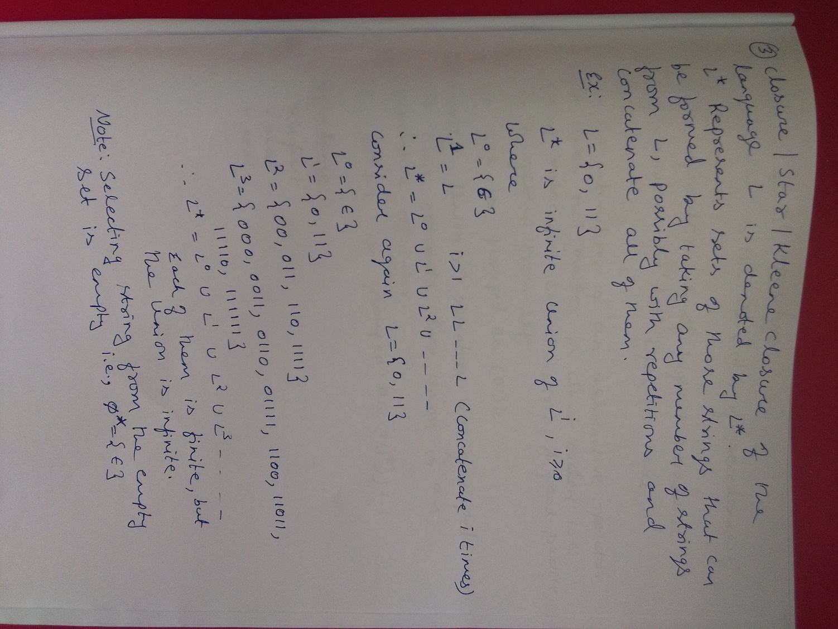

Slide 9
Precedence of Regular Expression Operators
Operator | Precedence
* Star Closure | Highest
. Concatenation | Next
+ Union | Next

Slide 10
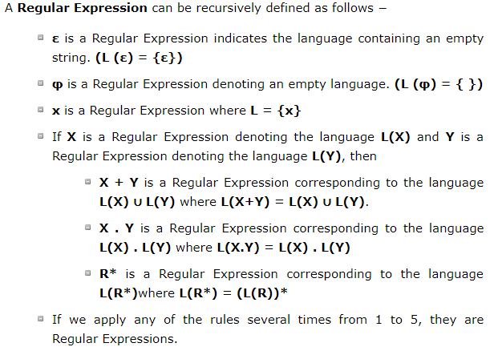
Regular Expression (RE)
An finite combination of Concatenation, Union and Kleene closure leads to a regular expression.

Slide 11
Rough Slide to explain examples of RE’s
1. a(aa)*
2. (a+b)*

Slide 12
Rough Slide to explain examples of RE’s
3. 01* + 10*

Slide 13
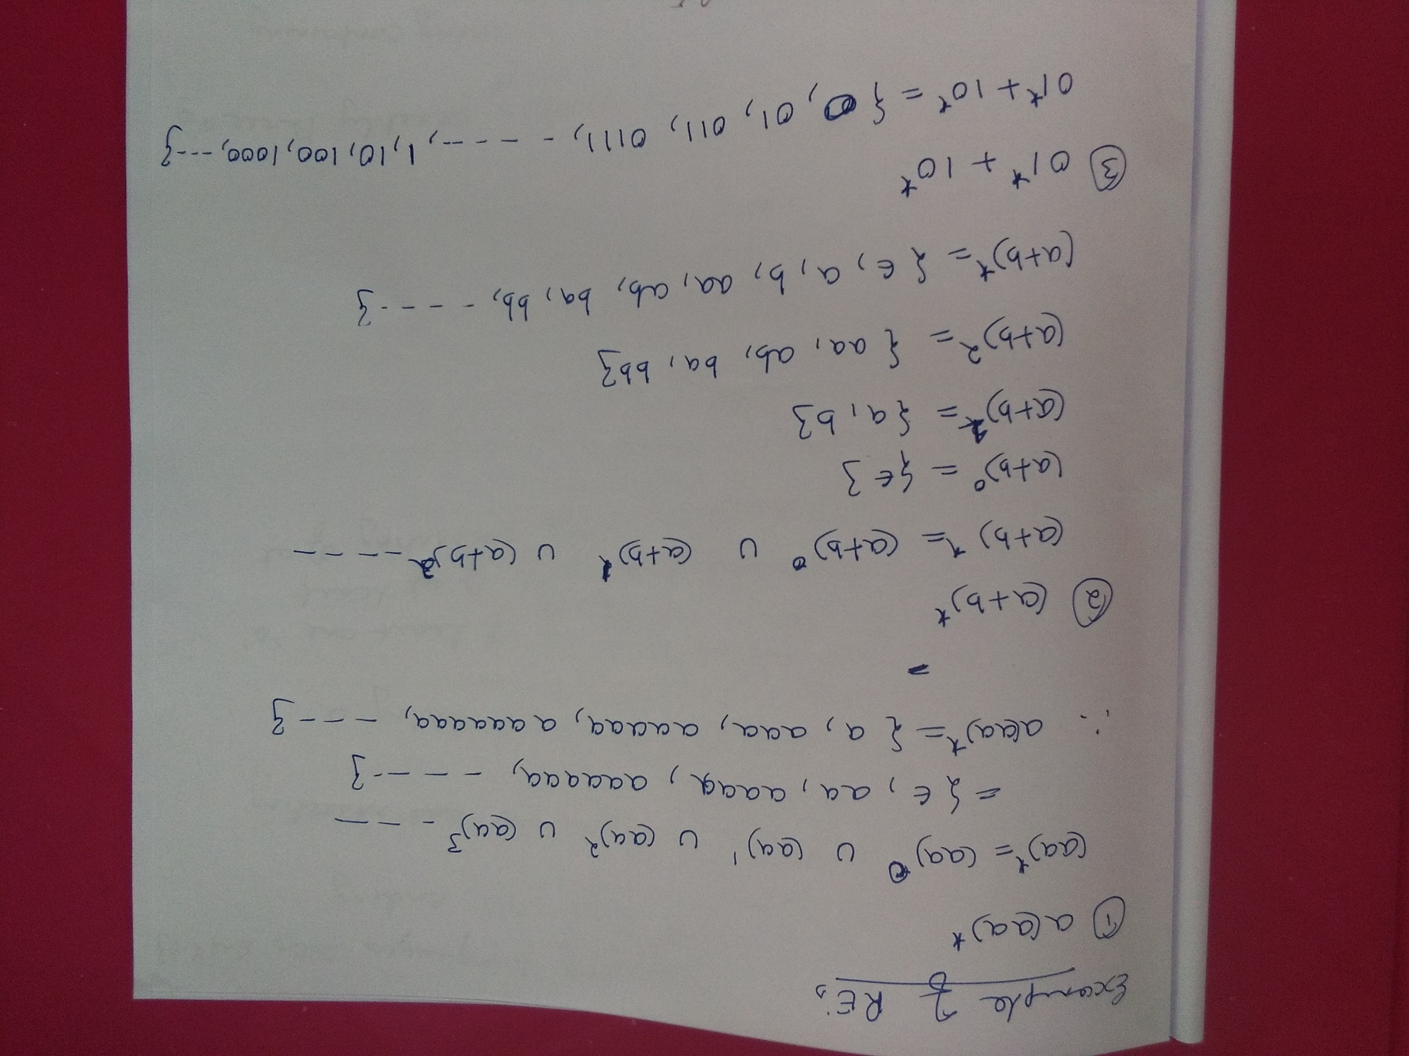

Slide 14
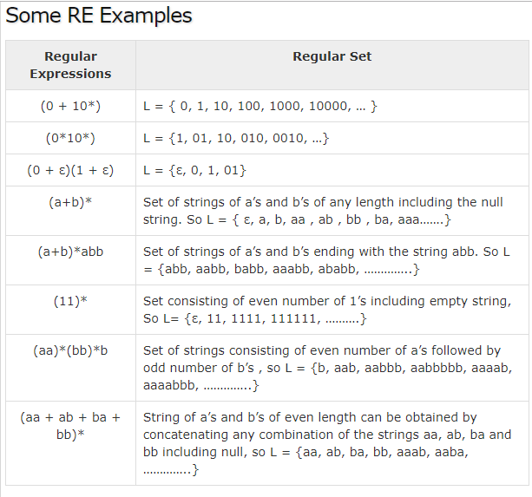

Slide 15
Questions
Obtain Regular Expressions (RE) for the following language over Σ ={a,b}
i. Set of string of a’s and b’s ending with string “abb”
ii. Set of string of a’s and b’s starting with string “ab”
iii. Set of string of a’s and b’s having substring “aa”
iv. Set of strings consisting of atleast one “a” followed by string consisting of atleast one “b”
v. Set of strings that contain exactly three a’s
vi. Strings of a’s and b’s containing no more than three a’s
vii. Strings of a’s and b’s ending with either “ab” or “ba”
viii. Strings of a’s and b’s, starting with “a” and ending with “b”
ix. Strings of a’s and b’s whose lengths are multiples of 3
x. Strings of a’s and b’s such that fourth symbol from right end is “a” and fifth symbol from right end is “b”

Slide 16
Questions
Obtain Regular Expressions (RE) for the following language over Σ ={a,b}
i. Set of string of a’s and b’s ending with string “abb”

Slide 17
Questions
Obtain Regular Expressions (RE) for the following language over Σ ={a,b}
ii. Set of string of a’s and b’s starting with string “ab”
iii. Set of string of a’s and b’s having substring “aa”
iv. Set of strings consisting of atleast one “a” followed by string consisting of atleast one “b”

Slide 18
Questions
Obtain Regular Expressions (RE) for the following language over Σ ={a,b}
i. Set of string of a’s and b’s ending with string “abb”
ii. Set of string of a’s and b’s starting with string “ab”
iii. Set of string of a’s and b’s having substring “aa”
iv. Set of strings consisting of atleast one “a” followed by string consisting of atleast one “b”
Answer:
i. (a+b)*abb
ii. ab(a+b)*
iii. (a+b)*aa(a+b)*
iv. aa*bb*

Slide 19
Questions
Obtain Regular Expressions (RE) for the following language over Σ ={a,b}
v. Set of strings that contain exactly three a’s
vi. Strings of a’s and b’s containing no more than three a’s

Slide 20
Questions
Obtain Regular Expressions (RE) for the following language over Σ ={a,b}
v. Set of strings that contain exactly three a’s
vi. Strings of a’s and b’s containing no more than three a’s
Answer:
v. b*ab*ab*ab*
vi. b*(ε+a)b*(ε+a)b*(ε+a)b*

Slide 21
Questions
Obtain Regular Expressions (RE) for the following language over Σ ={a,b}
vii. Strings of a’s and b’s ending with either “ab” or “ba”
viii. Strings of a’s and b’s, starting with “a” and ending with “b”

Slide 22
Questions
Obtain Regular Expressions (RE) for the following language over Σ ={a,b}
vii. Strings of a’s and b’s ending with either “ab” or “ba”
viii. Strings of a’s and b’s, starting with “a” and ending with “b”
Answer:
vii. (a+b)*ab+(a+b)*ba (OR) (a+b)*(ab+ba)
viii. a(a+b)*b

Slide 23
Questions
Obtain Regular Expressions (RE) for the following language over Σ ={a,b}
ix. Strings of a’s and b’s whose lengths are multiples of 3
x. Strings of a’s and b’s such that fourth symbol from right end is “a” and fifth symbol from right end is “b”

Slide 24
Questions
Obtain Regular Expressions (RE) for the following language over Σ ={a,b}
ix. Strings of a’s and b’s whose lengths are multiples of 3
x. Strings of a’s and b’s such that fourth symbol from right end is “a” and fifth symbol from right end is “b”
Answer:
ix. ((a+b)(a+b)(a+b))* (OR) ((a+b)³)*
x. (a+b)*ba(a+b)³

Slide 25
Question
Obtain a regular expression to accept a language consisting of strings of a’s and b’s with alternate a’s and b’s

Slide 26
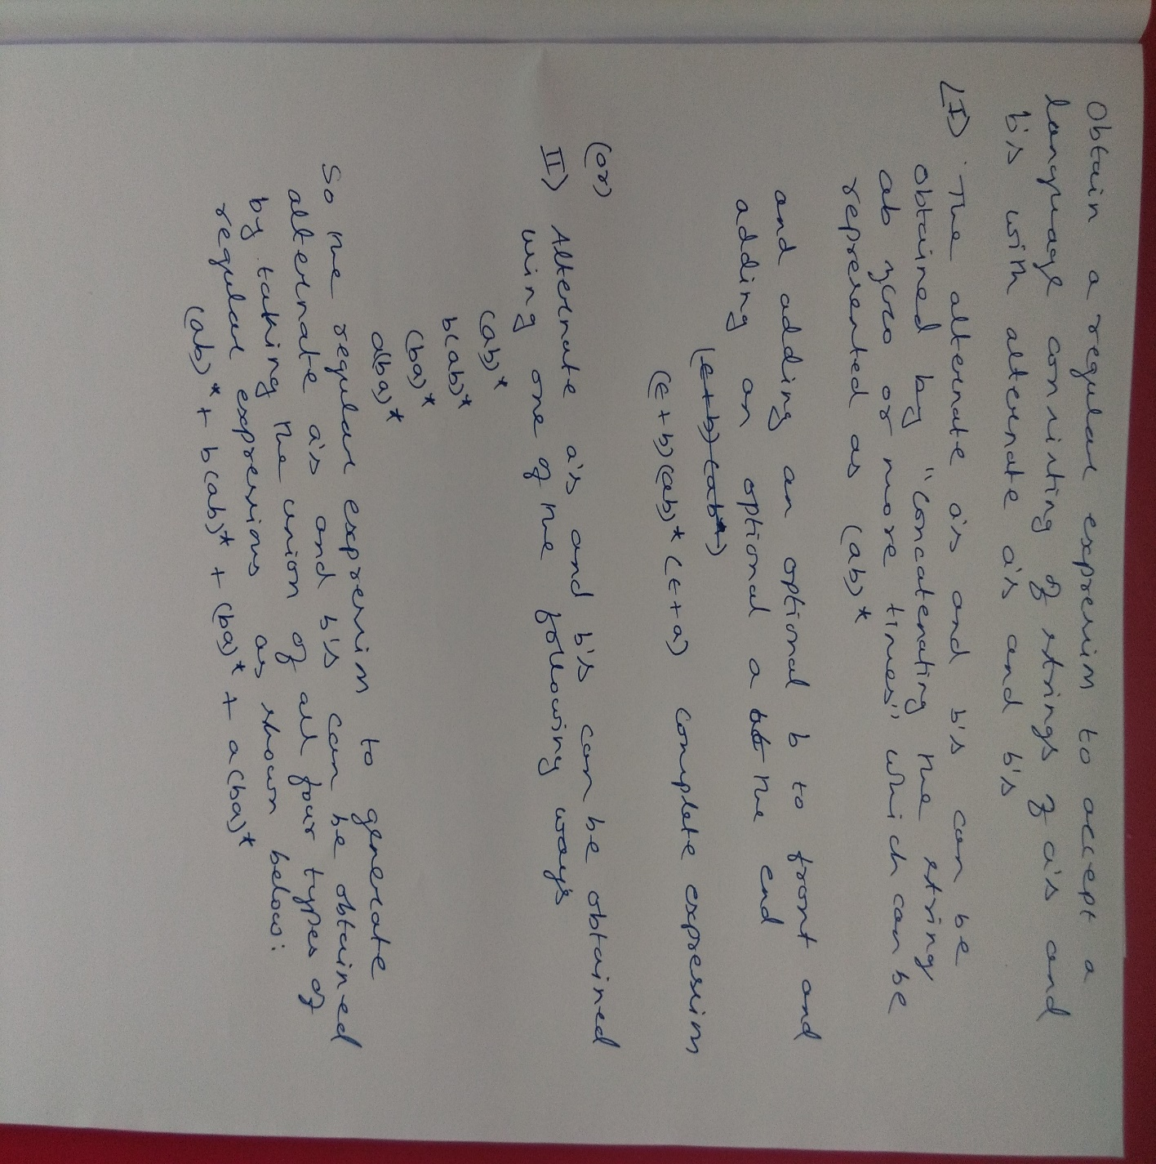
Answer

Slide 27
Question
Write Regular Expression for the following Languages
L={a^{2m}b^{2m+1} , m>=0, n>=0}
L={a^{n}b^{m} , (n+m) is even}
L={a^{n}b^{m}, n>=4, m<=3}
L={a^{n}b^{m}, n>=1, m>=1, nm>=3}

Slide 28
Rough Slide
Write Regular Expression for the following Languages
L={a^{2m}b^{2n+1} , m>=0, n>=0}

Slide 29
Rough Slide
Write Regular Expression for the following Languages
ii. L={a^{n}b^{m} , (n+m) is even}

Slide 30
Rough Slide
Write Regular Expression for the following Languages
iii. L={a^{n}b^{m}, n>=4, m<=3}

Slide 31
Rough Slide
Write Regular Expression for the following Languages
iv. L={a^{n}b^{m}, n>=1, m>=1, nm>=3}

Slide 32
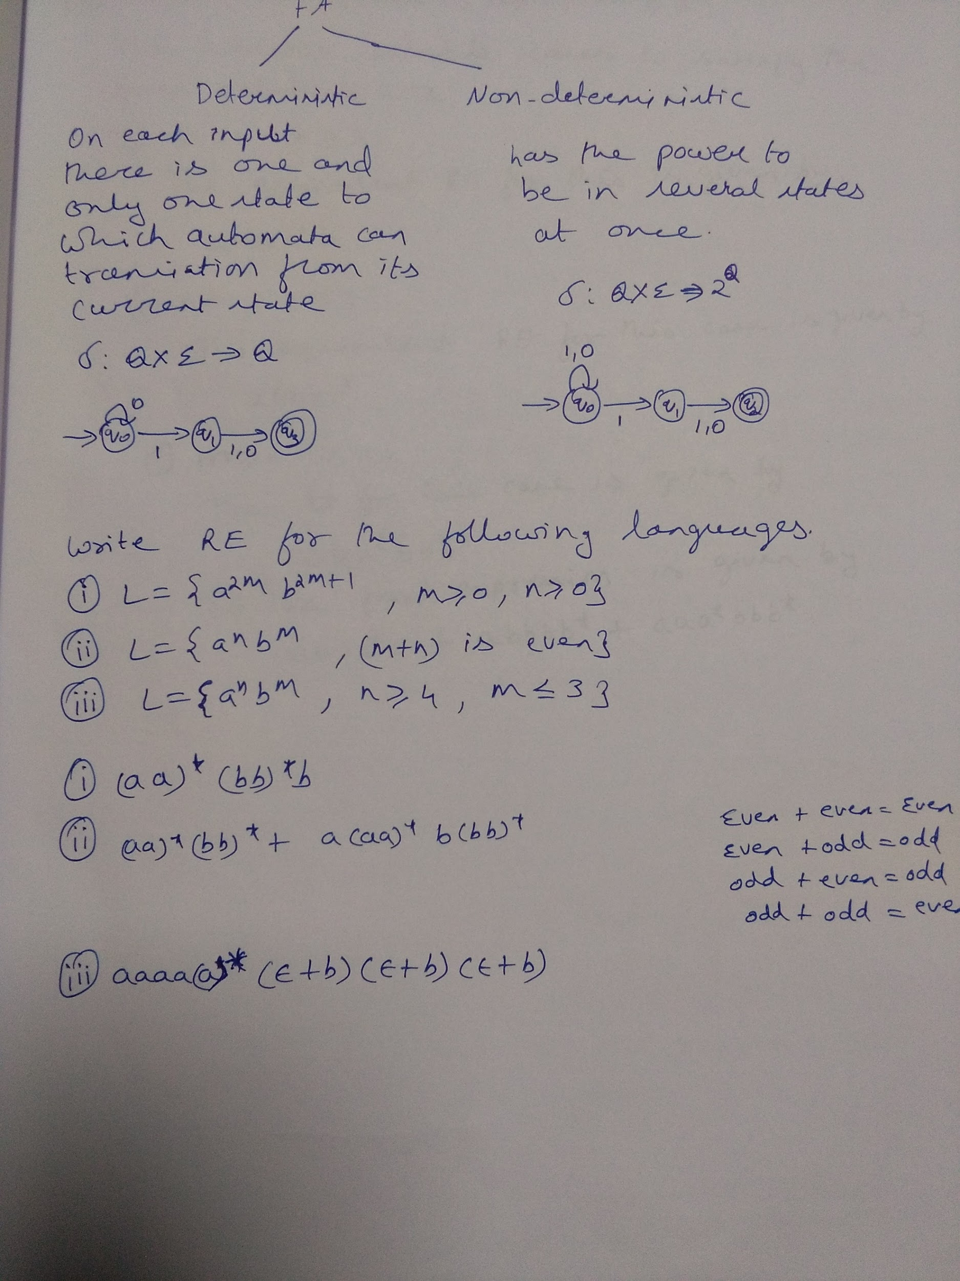

Slide 33
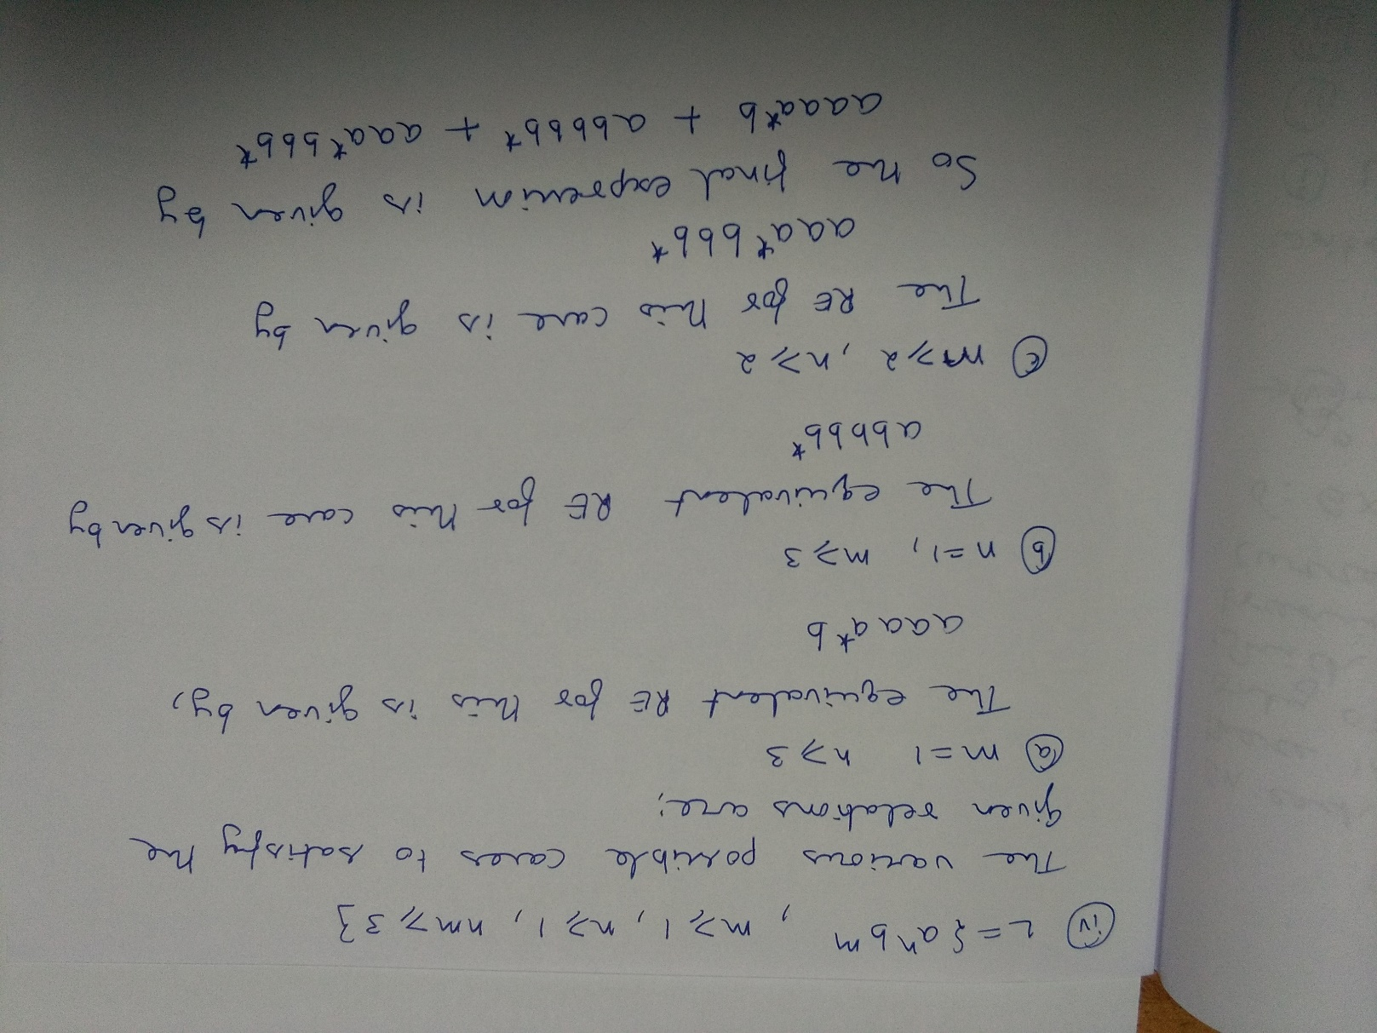

Slide 34
Question
Obtain a regular expression to accept strings of a’s and b’s ending with “b” and has no substring “aa”

Slide 35
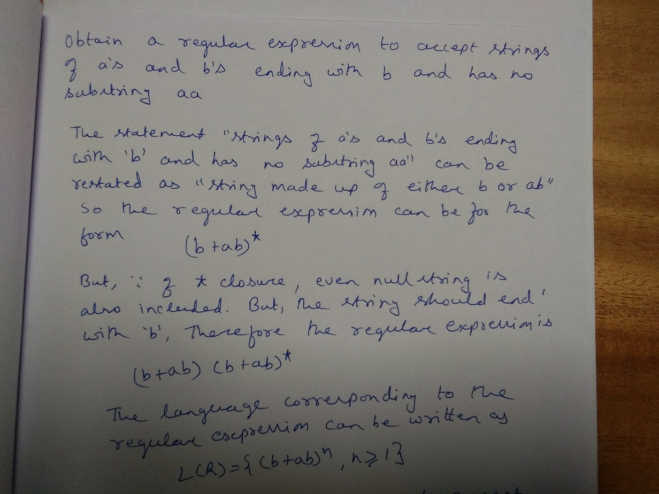
Question
Obtain a regular expression to accept strings of a’s and b’s ending with “b” and has no substring “aa”

Slide 36
Question
Obtain a regular expression to accept strings of 0’s and 1’s having no two consecutive zeros

Slide 37
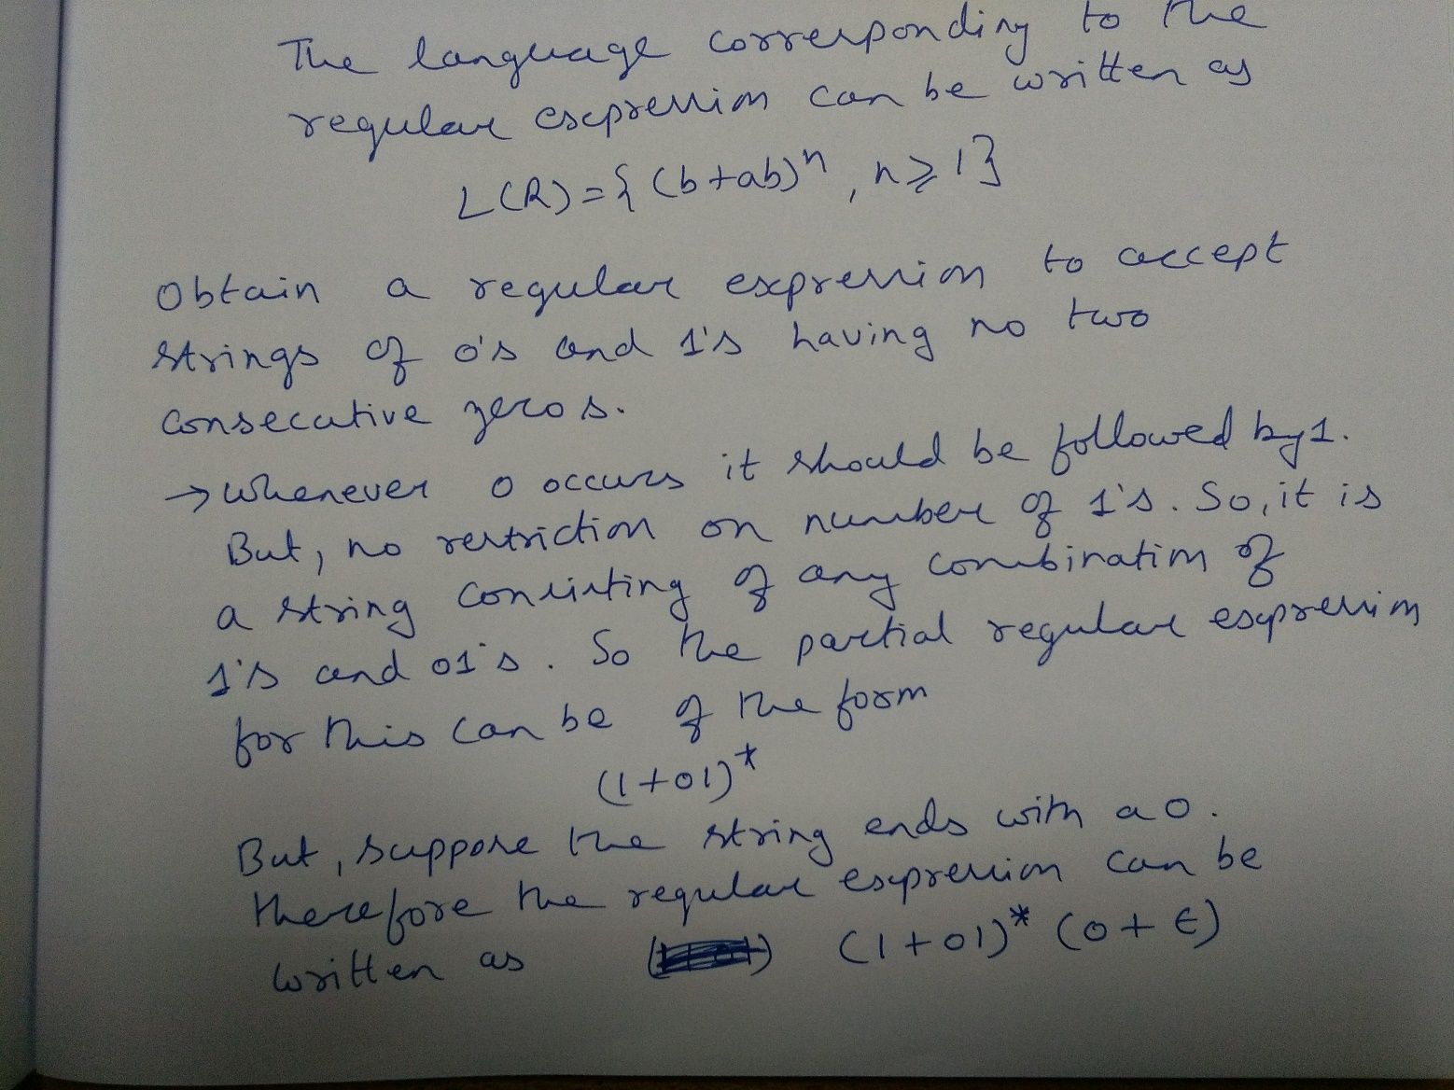
Question
Obtain a regular expression to accept strings of 0’s and 1’s having no two consecutive zeros

Slide 38
Question
Which of the following pairs of regular expressions are equivalent?
a. | 1(01)* and (10)*1
b. | x (xx)* and (xx)*x
c. | All of the mentioned

Slide 39
Question
Which of the following pairs of regular expressions are equivalent?
a. | 1(01)* and (10)*1
b. | x (xx)* and (xx)*x
c. | All of the mentioned
Answer: (c).All of the mentioned

Slide 40
Question
The Regular Expression gives none or many instances of an x or y is
a. | (x+y)
b. | (x+y)*
c. | (x* + y)
d. | (xy)*

Slide 41
Question
The Regular Expression gives none or many instances of an x or y is
a. | (x+y)
b. | (x+y)*
c. | (x* + y)
d. | (xy)*

Slide 42
Question
The regular expression denote a language comprising all possible strings of even length over the alphabet (0, 1)
a. | 1 + 0(1+0)*
b. | (0+1) (1+0)*
c. | (1+0)
d. | (00+0111+10)*

Slide 43
Question
The regular expression denote a language comprising all possible strings of even length over the alphabet (0, 1)
a. | 1 + 0(1+0)*
b. | (0+1) (1+0)*
c. | (1+0)
d. | (00+0111+10)*

Slide 44
Question
The RE in which any number of 0′s is followed by any number of 1′s followed by any number of 2′s is
a. | (0+1+2)*
b. | 0*1*2*
c. | 0* + 1 + 2
d. | (0+1)*2*

Slide 45
Question
What is the Regular Expression Matching Zero or More Specific Characters ?
a. | x
b. | #
c. | *
d. | &

Slide 46
Question
Give English descriptions of the languages of the following regular expressions.
(1 + ε)(00*1)*0*
(0*1*)*000(0 + 1)*
(0 + 10)*1*

Slide 47
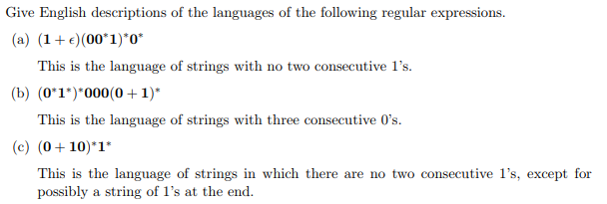
Answer

Slide 48
Homework Problems
Write regular expressions for the following languages.
The set of strings over alphabet {a, b, c} containing at least one “a” and at least one “b”
The set of strings of 0’s and 1’s whose tenth symbol from the right end is 1.
The set of strings of 0’s and 1’s with at most one pair of consecutive 1’s.

Slide 49
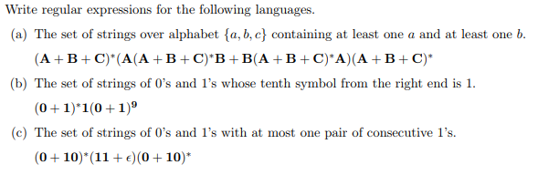
Answer
01

Slide 50
Homework Problems
Write regular expressions for the following languages over the alphabet Σ = {a, b}:
(a) All strings that do not end with “aa”
(b) All strings that contain an even number of b’s
(c) All strings which do not contain the substring ba

Slide 51
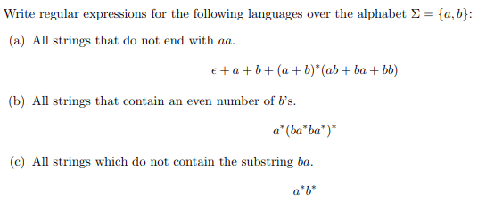
Answer

Slide 52
Converting Finite Automata to Regular Expressions
Two methods
1. By Kleene’s Theorem
2. By Eliminating States
i. Without loops between States
ii. With loops between States

Slide 53
Rough Slide to explain Example of finding RE for a given FA
a
a
q₁
q₂
q₀
q₁
b
q₂
b
b
q₀
a
q₁
c
q₂

Slide 54
Rough Slide to explain Example of finding RE for a given FA
a
q₁
q₂
b
a
q₁
q₂
b

Slide 55
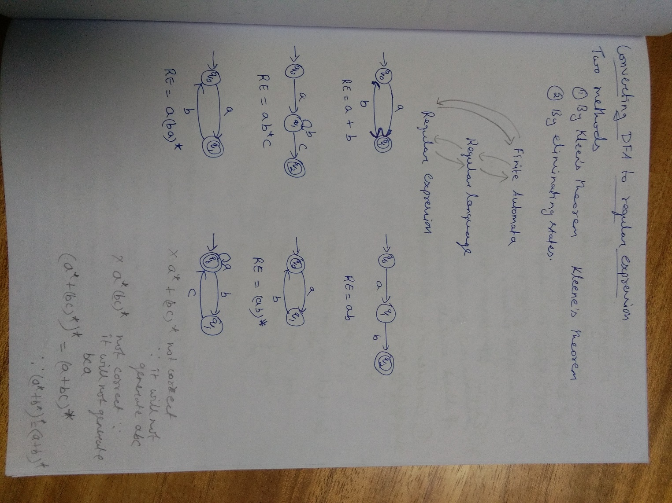

Slide 56
Sample RE, FA and RL
FA | RE | Language
 | ∅ | L = { }
 | ε | L= { ε }
 | a | L = { a }
 | ab | L = {ab}
 | a+b | L= { a , b}
 | a*b | L = {b, ab, aab,….}
0 , 1
q₂
q₁
q₂
a
q₂
q₁
a
b
q₀
q₁
q₂
a
q₁
q₂
b
a
b
q₁
q₂

Slide 57
Note
∅ It is a Language containing no string ; No element
ε It is a language containing exactly one string , which has length zero
{ε}. {a} = {a}. {ε} = {a}
∅ . {a} = {a} . ∅ = ∅

Slide 58
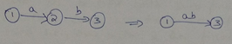
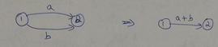
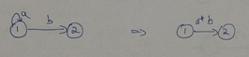
Converting FA to RE by Eliminating States
Case 1: Without loops between states
Note: In State Elimination method,
We are going to eliminate all intermediate
states except the start state and final sate.
We should have one transition from start
to final state.

Slide 59
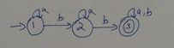
Converting FA to RE by Eliminating States Rough Slide
Case 1: Without loops between states

Slide 60
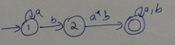
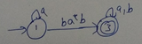
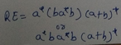
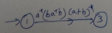
Converting FA to RE by Eliminating States
Case 1: Without loops between states

Slide 61
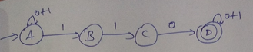
Converting FA to RE by Eliminating States Rough Slide
Case 1: Without loops between states

Slide 62
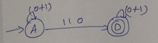
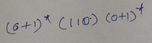
Converting FA to RE by Eliminating States
Case 1: Without loops between states

Slide 63
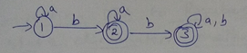
Converting FA to RE by Eliminating States Rough Slide
Case 1: Without loops between states

Slide 64
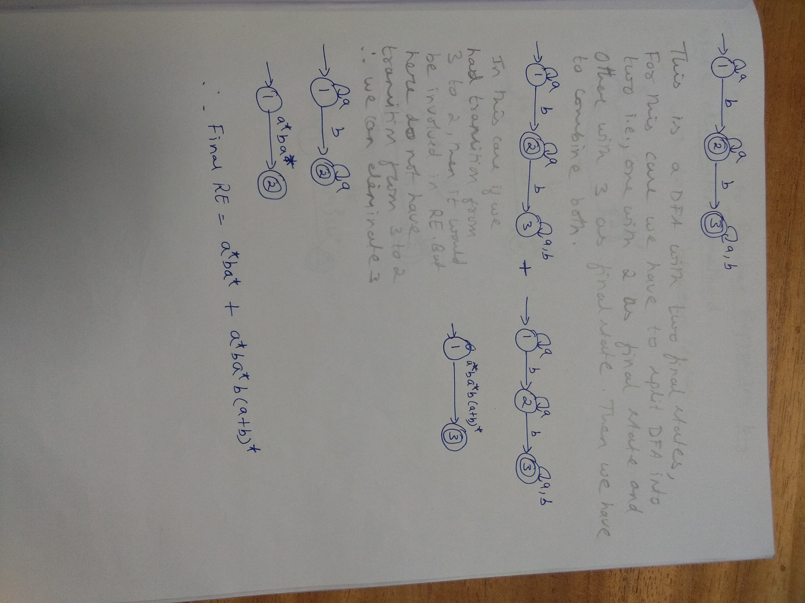

Slide 65
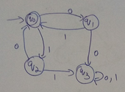
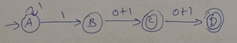
Converting FA to RE by Eliminating States
Case 1: Without loops between states
Homework Problems

Slide 66
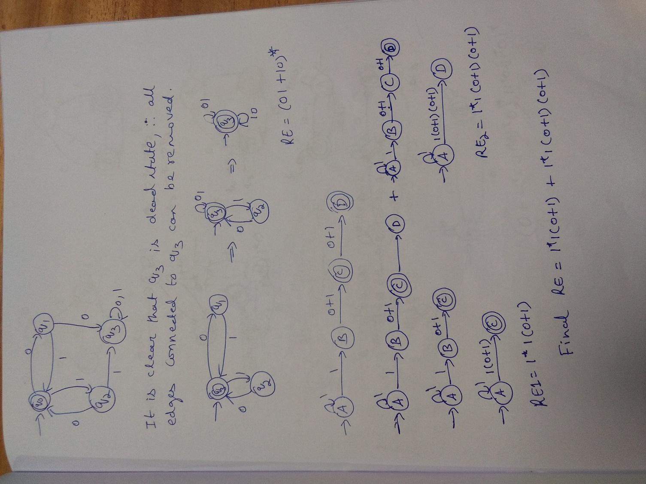

Slide 67
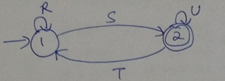
Converting FA to RE by Eliminating States Rough Slide
Case 2: With loops between states

Slide 68
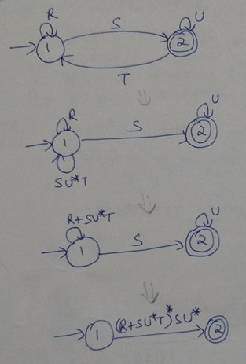
Converting FA to RE by Eliminating States
Case 2: With loops between states

Slide 69
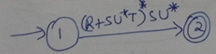
Converting FA to RE by Eliminating States Rough Slide
Case 2: With loops between states
1
A
0
B
0
C
1
0,1
Intermediate State here is B
AA A → A A → B →A
AC A → C A → B →C
CA C → A C → B →A
CC C → C C→ B →C

Slide 70
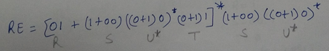
Converting FA to RE by Eliminating States
Case 2: With loops between states
1
A
0
B
0
C
1
0,1
Intermediate State here is B
AA 01 A → A A → B →A
AC 1+00 A → C A → B →C
CA (0+1)1 C → A C → B →A
CC (0+1)0 C → C C→ B →C
01
(0+1)0
A
1+00
C
(0+1)1

Slide 71
Converting FA to RE by Eliminating States Rough Slide
Case 2: With loops between states
1
0
0
A
0
B
1
C
1
Intermediate State here is B
AA A → A A → B →A
AC A → C A → B →C
CA C → A C → B →A
CC C → C C→ B →C
Note:
∅ means no Path

Slide 72
Converting FA to RE by Eliminating States
Case 2: With loops between states
1
0
0
A
0
B
1
C
1
Intermediate State here is B
AA 1 A → A A → B →A
AC 00*1 A → C A → B →C
CA ∅ C → A C → B →A
CC 0+10*1 C → C C→ B →C
Note:
∅ means no Path
1
0+10*1
A
00*1
C
Final Regular Expression = 1*00*1(0+10*1)*

Slide 73
Converting FA to RE by Eliminating States
Case 2: With loops between states
0
0+1
A
1
B
1
C
0
0+10
0+1
A
11
C
RE=(0+10)*11(0+1)*

Slide 74
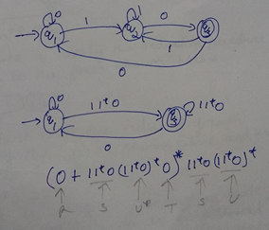
Converting FA to RE by Eliminating States
Case 2: With loops between states

Slide 75
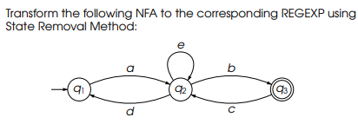
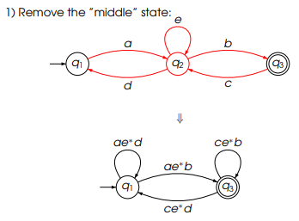
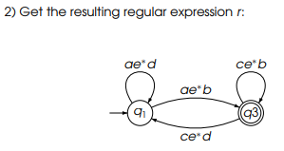

Slide 76
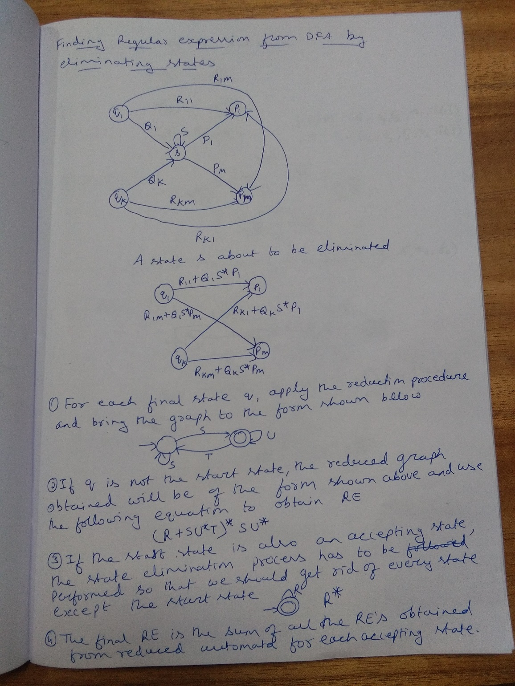

Slide 77
Converting Finite Automata to Regular Expressions
Two methods
1. By Kleene’s Theorem
2. By Eliminating States
i. Without loops between States
ii. With loops between States

Slide 78
Converting FA to Regular Expression using Kleene’s Theorem
Let M= (Q, Σ, δ, q, F) be the finite automata recognizing the language L=L(M). Then there exists an equivalent Regular Expression (RE) R for the regular language such that L = L(R)
Let Q={q₁ , q₂ , q₃…q_{n}} states of the machine M with n states. By renaming the states, we can refer then as first n positive integers i.e., Q={1, 2, 3…n}
Let us use,
R^{k}_{ij} , to represent the a regular expression
R^{k}_{ij} = { w ∈ Σ*, w is the label of a path from
state i to state j that goes through
an intermediate state whose number
is not greater than k}
R^{(k-1)}_{kk}
_{i}
_{k}
_{j}
R^{(k-1)}_{ik}
R^{(k-1)}_{kj}

Slide 79
Converting FA to Regular Expression using Kleene’s Theorem (Contd…)
R^{(k-1)}_{kk}
I. RE passing through intermediate states
R^{k}_{ij} = R^{(k-1)}_{ij} +R^{(k-1)}_{ik} . (R^{(k-1)}_{kk})* . R^{(k-1)}_{kj}
II. RE for direct edge i≠j
_{i}
_{k}
_{j}
R^{(k-1)}_{ik}
R^{(k-1)}_{kj}
 | Description | Example
R⁰_{ij} = ∅ | For no input symbol
R⁰_{ij} = a | For exactly one input symbol
R⁰_{ij} = a₁+a₂+…a_{m} | For transition from state i to state j on input symbols a₁, a₂, …a_{m}
q₁
q₂
q₁
a
q₂
a
q₁
q₂
b

Slide 80
Converting FA to Regular Expression using Kleene’s Theorem (Contd…)
II. RE for direct edge i == j
There is only one state such that i==j and there exists a path from state i to itself on input symbol ’a’ forming a self loop or a path of length 0 (i.e., if no loop path from state i to state j then there is a path of length 0) and is denoted by ε . Thus the RE corresponding to various cases
RE for direct edge i == j | Description
R⁰_{ij} = ε | For no input symbol
R⁰_{ij} = a + ε | For exactly one input symbol
R⁰_{ij} = a₁+a₂+…a_{m}+ ε | For transition from state i to state j on input symbols a₁, a₂, …a_{m}
q₁
a
q₁
q₁
a , b

Slide 81
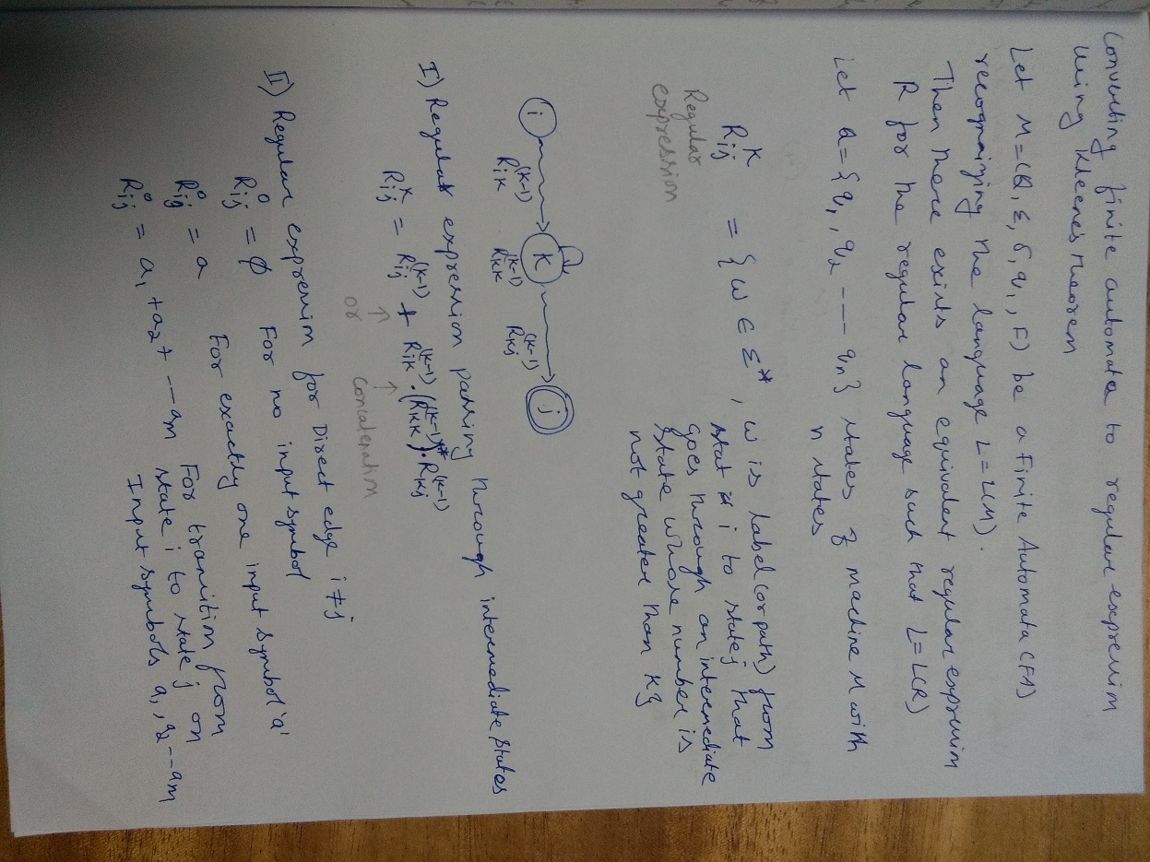
Converting FA to Regular Expression using Kleene’s Theorem

Slide 82
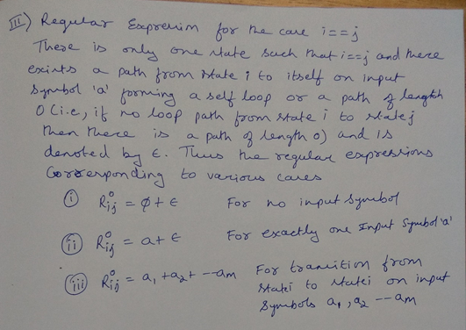
Converting DFA to Regular Expression

Slide 83
Convert following Finite Automata to Regular Expression using Kleene’s theorem
1
0
q₁
0
q₂
1
q₃
1

Slide 84
Rough Slide:Convert following Finite Automata to Regular Expression using Kleene’s theorem
1
0
q₁
0
q₂
1
q₃
1
1
0
1
0
2
1
3
1

Slide 85
Rough Slide:Convert following Finite Automata to Regular Expression using Kleene’s theorem
1
0
A+ε ={ε, A}
A+∅ ={A}
A.ε ={A}
A.∅ ={ }
1
0
2
1
3
1
R^{k}_{ij} = R^{(k-1)}_{ij} +R^{(k-1)}_{ik} . (R^{(k-1)}_{kk})* . R^{(k-1)}_{kj}
R³₁₃ = R²₁₃ +R²₁₃ . (R²₃₃)* . R²₃₃

Slide 86
Rough Slide:Convert following Finite Automata to Regular Expression using Kleene’s theorem
1
0
A+ε ={ε, A}
A+∅ ={A}
A.ε ={A}
A.∅ ={ }
1
0
2
1
3
1
R^{k}_{ij} = R^{(k-1)}_{ij} +R^{(k-1)}_{ik} . (R^{(k-1)}_{kk})* . R^{(k-1)}_{kj}
R³₁₃ = R²₁₃ +R²₁₃ . (R²₃₃)* . R²₃₃
R²₁₃ = R¹₁₃ +R¹₁₂ . (R¹₂₂)* . R¹₂₃
R²₃₃ = R¹₃₃ +R¹₃₂ . (R¹₂₂)* . R¹₂₃

Slide 87
Rough Slide:Convert following Finite Automata to Regular Expression using Kleene’s theorem
1
0
R^{k}_{ij} = R^{(k-1)}_{ij} +R^{(k-1)}_{ik} . (R^{(k-1)}_{kk})* . R^{(k-1)}_{kj}
1
0
2
1
3
A+ε ={ε, A}
A+∅ ={A}
A.ε ={A}
A.∅ ={ }
1
R²₁₃ = R¹₁₃ +R¹₁₂ . (R¹₂₂)* . R¹₂₃
R²₃₃ = R¹₃₃ +R¹₃₂ . (R¹₂₂)* . R¹₂₃
R¹₁₃ = R⁰₁₃ +R⁰₁₁ . (R⁰₁₁)* . R⁰₁₃
R¹₃₃ = R⁰₃₃ +R⁰₃₁ . (R⁰₁₁)* . R⁰₁₃
R¹₂₂ = R⁰₂₂ +R⁰₂₁ . (R⁰₁₁)* . R⁰₁₂
R¹₃₂ = R⁰₃₂ +R⁰₃₁ . (R⁰₁₁)* . R⁰₁₂

Slide 88
Rough Slide:Convert following Finite Automata to Regular Expression using Kleene’s theorem
1
0
R^{k}_{ij} = R^{(k-1)}_{ij} +R^{(k-1)}_{ik} . (R^{(k-1)}_{kk})* . R^{(k-1)}_{kj}
1
0
2
1
3
A+ε ={ε, A}
A+∅ ={A}
A.ε ={A}
A.∅ ={ }
1
R¹₂₃ = R⁰₂₃ +R⁰₂₁ . (R⁰₁₁)* . R⁰₁₃

Slide 89
Rough Slide:Convert following Finite Automata to Regular Expression using Kleene’s theorem
1
0
R^{k}_{ij} = R^{(k-1)}_{ij} +R^{(k-1)}_{ik} . (R^{(k-1)}_{kk})* . R^{(k-1)}_{kj}
1
0
2
1
3
A+ε ={ε, A}
A+∅ ={A}
A.ε ={A}
A.∅ ={ }
1
R¹₁₂ = R⁰₁₂ +R⁰₁₁ . (R⁰₁₁)* . R⁰₁₂

Slide 90
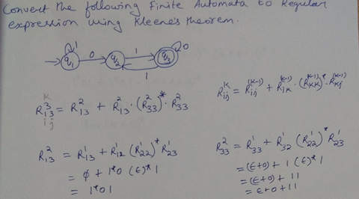

Slide 91
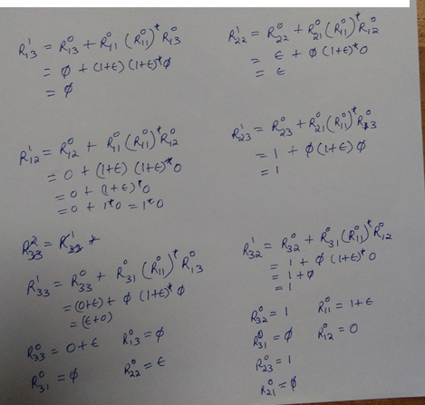

Slide 92
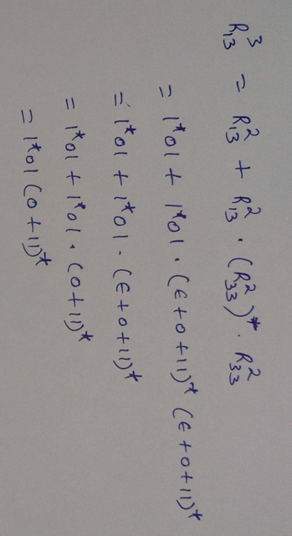

Slide 93
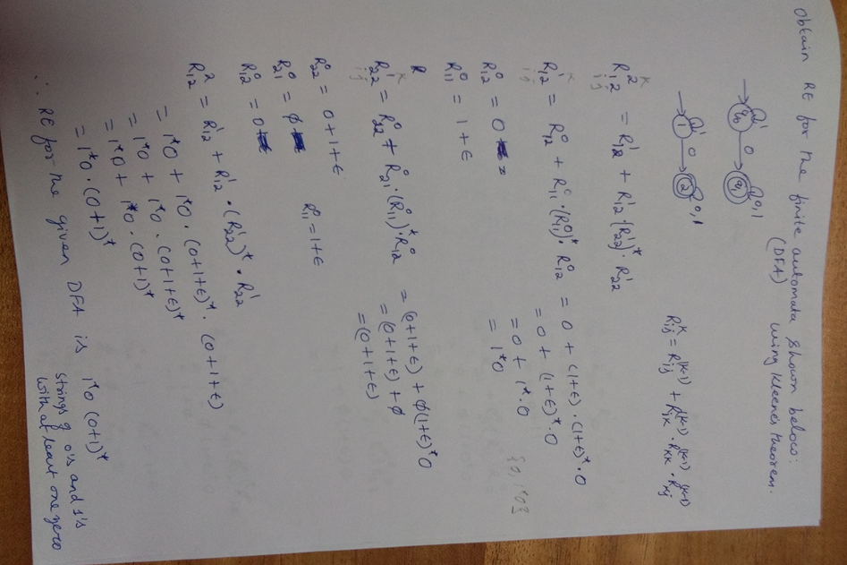

Slide 94
Converting Regular Expression to Finite Automata

Slide 95
Converting Regular Expression to Finite Automata
Regular Expression | ε - NFA
∅
ε
a
q₁
q₂
q₁
ε
q₂
q₁
a
q₂

Slide 96
Converting Regular Expression to Finite Automata (Contd…)
Regular Expression | ε - NFA
R=R₁+R₂ | L(R₁) M₁ =(Q₁, Σ₁, δ₁, q₁, {f₁}) L(R₂) M₂ =(Q₂ , Σ₂ , δ₂ , q₂ , {f₂}) L(R₁+R₂) M = ( Q ₁ U Q₂ U {q₀, q_{f}}, Σ₁ U Σ₂ , δ, q₀ , {q_{f}})
L(R₁)
ε
q₁
f₁
ε
q₀
M₁
q_{f}
ε
L(R₂)
ε
q₂
f₂
M₂

Slide 97
Converting Regular Expression to Finite Automata (Contd…)
Regular Expression | ε - NFA
R = R₁ . R₂ | L(R₁) M₁ =(Q₁, Σ₁, δ₁, q₁, {f₁}) L(R₂) M₂ =(Q₂ , Σ₂ , δ₂ , q₂ , {f₂}) L(R₁ . R₂) M = ( Q₁ U Q₂ , Σ₁ U Σ₂ , δ, q₁ , {f₂})
L(R₁)
L(R₂)
ε
q₁
f₁
q₂
f₂
M₁
M₂

Slide 98
Converting Regular Expression to Finite Automata (Contd…)
Regular Expression | ε - NFA
R= (R₁)* | L(R₁) M₁ =(Q ₁, Σ₁, δ₁, q₁, {f₁}) L(R₁*) = ( Q ₁ U {q₀, f₀}, Σ₁ , δ, q₀ , {q_{f}})
ε
L(R₁)
q₀
q₁
f₁
q_{f}
ε
ε
M₁
ε

Slide 99
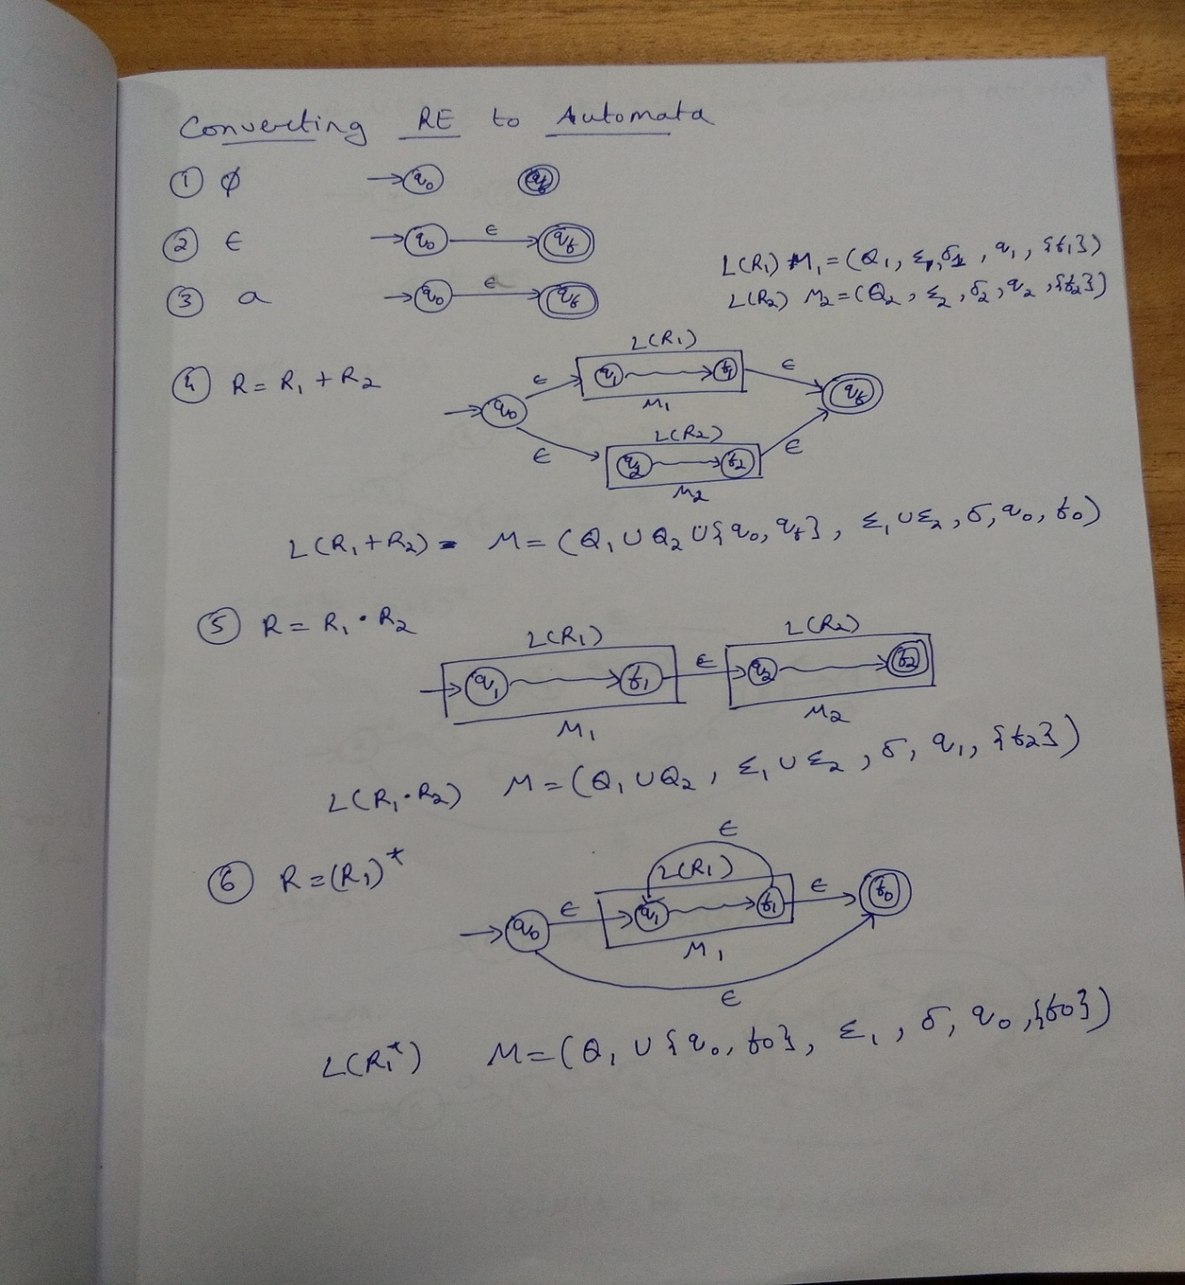

Slide 100
Question
Obtain ε – NFA for the regular expression ab(a+b)*

Slide 101
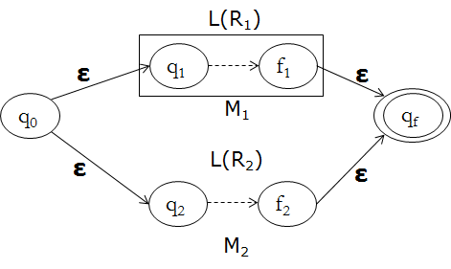
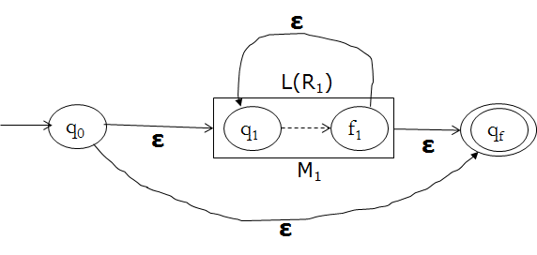
Obtain ε – NFA for the regular expression ab(a+b)* Rough Slide
R=R₁+R₂
R=(R₁)*

Slide 102
Obtain ε – NFA for the regular expression ab(a+b)* Rough Slide

Slide 103
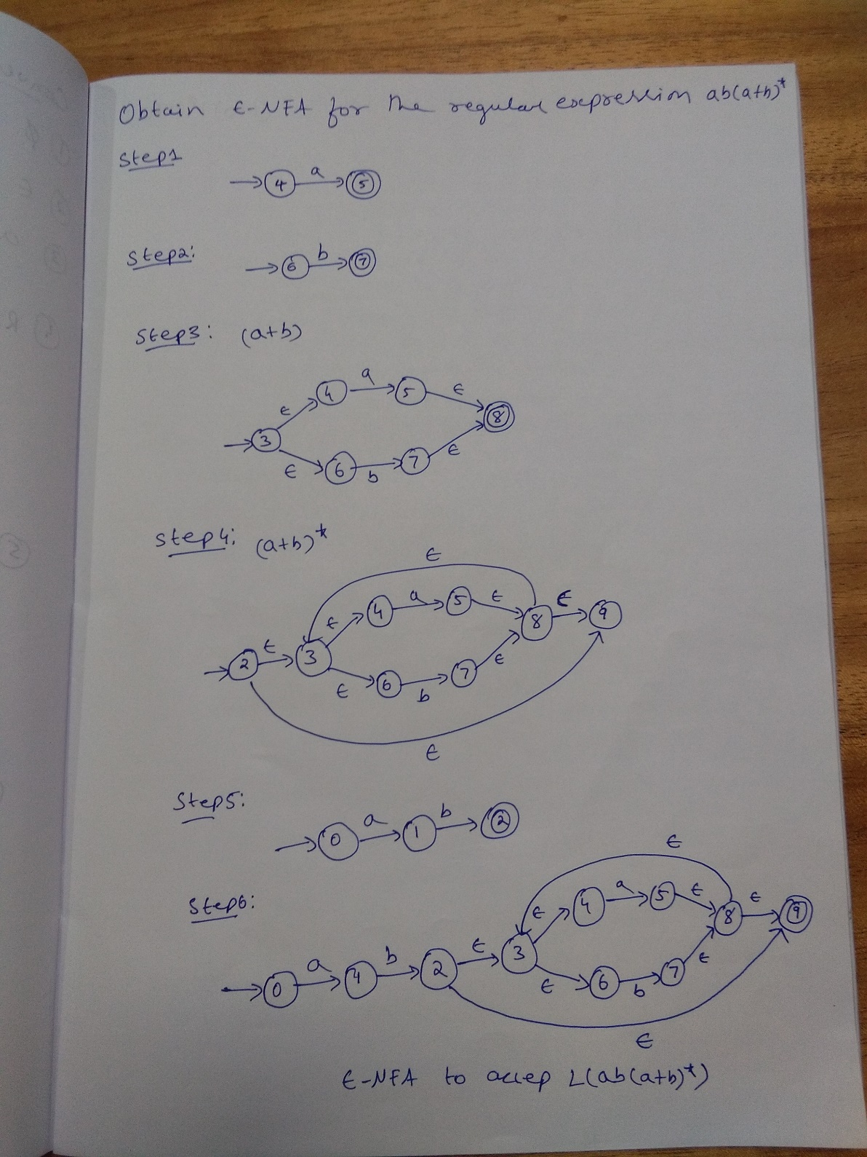

Slide 104
Homework Problem
Obtain ε – NFA for the regular expression
(0+1)*1(0+1)

Slide 105
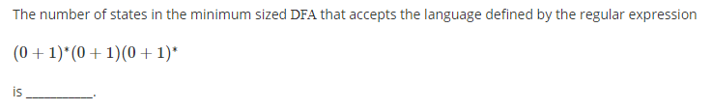
Question

Slide 106
Question
Answer: 2

Slide 107
Question
The number of states in the minimal deterministic finite automaton corresponding to the regular expression
(0 + 1)*(10) is _______

Slide 108
Question
The number of states in the minimal deterministic finite automaton corresponding to the regular expression
(0 + 1)*(10) is _______
Answer: 3

Slide 109
Question
Let N be an NFA with n states. Let k be the number of states of a minimal DFA which is equivalent to N. Which one of the following is necessarily true?

Slide 110
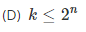
Question
Let N be an NFA with n states. Let k be the number of states of a minimal DFA which is equivalent to N. Which one of the following is necessarily true?
Answer:

Slide 111

Question
Consider the finite automaton in the following figure.
What is the set of reachable states for the input string 0011?
(A) {q₀, q₁, q₂} (B) {q₀, q₁}
(C) {q₀, q₁, q₂,q₃} (D) {q₃}

Slide 112
Question
Consider the finite automaton in the following figure.
What is the set of reachable states for the input string 0011?
(A) {q₀, q₁, q₂} (B) {q₂}
(C) {q₀, q₁, q₂,q₃} (D) {q₃}
Answer:
(A) {q₀, q₁, q₂}

Slide 113
Unit-2
Pumping Lemma

Slide 114
Why you Should Learn Pumping Lemma ?
Can you construct DFA or NFA for the following Languages
L={a^{n}b^{m}, n >= 1, m >= 1 }
L={a^{n}b^{n}, n>=1}
L={w ∈ Σ* , n_{a}(w) < n_{b}(w) where Σ={a,b}}

Slide 115
What is the purpose of Pumping Lemma ?
To prove certain languages are not regular
Non regular language is that language for which a finite automata cannot be constructed.
Regular languages has four descriptions: DFA, NFA, ε-NFA, Regular Expression

Slide 116
Pumping Lemma Statement
Let M= (Q, Σ, δ, q₀, F) be a finite automata and has n states. Let L be the regular language accepted by M. For every string x in L, there exists a constant n such that |x|>=n . Now, if the string x can be broken into three substrings u, v and w such that x=uvw
Satisfying the following constraints:
|v| >=1
|uv| <= n
For all i>=0, the string uv^{i}w is also in L
Note: Every sufficiently long string in L can be broken into three parts such a way that an arbitrary number of repetitions of the middle part yields another string in L. Middle string in pumped, hence the term pumping lemma.

Slide 117

Example for illustration of Pumping lemma Rough Slide
L={(ab)^{m}b , m ≥ 1}
Pumping Lemma Statement:
For every string x in L, there exists a
constant n such that |x|>=n . Now, if the
string x can be broken into three substrings
u, v and w such that x=uvw
Satisfying the following constraints:
|v| >=1
|uv| <= n
For all i>=0, the string uv^{i}w is also in L

Slide 118
Example for illustration of Pumping lemma Rough Slide
L={(ab)^{m}b , m ≥ 1}
Number of States n= 4
Consider x = ababb , |x|=5≥n ; |x|>=n
X=ababb
|ab|=2 ≥1 ; |v| >=1
|abab|=4 ≤ 4 ; |uv| <= n
For all i>=0, the string uv^{i}w is also in L
ab(ab)^{i}b ∈ L
Pumping Lemma Statement:
For every string x in L, there exists a
constant n such that |x|>=n . Now, if the
string x can be broken into three substrings
u, v and w such that x=uvw
Satisfying the following constraints:
|v| >=1
|uv| <= n
For all i>=0, the string uv^{i}w is also in L

Slide 119

Example for illustration of Pumping lemma

Slide 120
Example for illustration of Pumping lemma Rough Slide
a,b
L={(a+b)^{m}ab , m ≥ 0}
Number of States n= 3
Consider x = abab , |x|=4≥n ; |x|>=n
X = abab
|ab|=2 ≥1 ; |v| >=1
|ab|=2 ≤ 3 ; |uv| <= n
For all i>=0, the string uv^{i}w is also in L
(ab)^{i}ab ∈ L
1
a
2
b
3
Pumping Lemma Statement:
For every string x in L, there exists a
constant n such that |x|>=n . Now, if the
string x can be broken into three substrings
u, v and w such that x=uvw
Satisfying the following constraints:
|v| >=1
|uv| <= n
For all i>=0, the string uv^{i}w is also in L

Slide 121
Pumping Lemma to prove certain languages are not regular
Steps to be followed for Pumping Lemma in applying it for to proving whether the language is regular or not regular
Pick n
Pick x such that x belongs to L and |x|>=n
Decompose x into uvw such that |v| >=1 and |uv|<=n and
Pick i such that pumped string x defined by x =uv^{i}w is not in L
Note: Pumping Lemma is used to show that certain languages are not regular. The demonstration is always by contradiction

Slide 122
General Strategy to Prove certain language is not regular according to Pumping Lemma
Step 1: Assume the language L is regular and the number of states in finite automata be n
Step 2: Select the string say x and break it into substring u, v, and w such that x=uvw with the constraints |x|>=n, |v|>=1 and |uv|<=n
Step 3: Find i such that uv^{i}w ∉ L . According to pumping lemma, uv^{i}w ∈ L . So, the result is contradiction to the assumption that the language is regular. Therefore, the given language L is not regular.

Slide 123
Question
Show that the language
L={a^{n}b^{n}, n>=0} is not regular

Slide 124
Show that L={a^{n}b^{n}, n>=0} is not regular Rough Slide
i. Pick n
ii. Pick x such that x belongs to L and |x|>=n
iii. Decompose x into uvw such that |v| >=1
and |uv|<=n and
iv. Pick i such that pumped string x defined by
x =uv^{i}w is not in L
Step 1: Let L be the regular language
and n be the number of states in finite automaton

Slide 125
Show that L={a^{n}b^{n}, n>=0} is not regular Rough Slide
i. Pick n
ii. Pick x such that x belongs to L and |x|>=n
iii. Decompose x into uvw such that |v| >=1
and |uv|<=n and
iv. Pick i such that pumped string x defined by
x =uv^{i}w is not in L
Step 1: Let L be the regular language
and n be the number of states in finite automaton
Step 2: Consider the string
X = a^{n}b^{n} , |x| =|a^{n}b^{n} | = 2n ≥ n ; |x|>=n

Slide 126
Show that L={a^{n}b^{n}, n>=0} is not regular Rough Slide
i. Pick n
ii. Pick x such that x belongs to L and |x|>=n
iii. Decompose x into uvw such that |v| >=1
and |uv|<=n and
iv. Pick i such that pumped string x defined by
x =uv^{i}w is not in L
Step 1: Let L be the regular language
and n be the number of states in finite automaton
Step 2: Consider the string
X = a^{n}b^{n} , |x| =|a^{n}b^{n} | = 2n ≥ n ; |x|>=n
X = aa…..abb…..b
X= a^{n-k}a^{k}b^{n} |V| = |a^{k}| = k ≥1 ; |v| >=1
^{u v w}
|UV| =|a^{n-k}a^{k}| = n ≤ n ; |uv| <= n
Step 3: Then according to Pumping Lemma,for all i>=0, the string uv^{i}w ∈ L
But, for i=0 , a^{n-k}(a^{k})⁰b^{n} = a^{n-k}b^{n} ∉ L because number of a’s is less than number of b’s
Similarly, if i=2,3,…then the number of a’s will be more than number of b’s and so the number of a’s followed by equal number b’s does not exist. But, according to pumping lemma , n number of a’s should be followed by n number of b’s which is contradicting to assumption that language is regular. So, L={a^{n}b^{n}, n>=0} is not regular
n
n

Slide 127
Show that L={a^{n}b^{n}, n>=0} is not regular
Step 1: Let L be the regular language and n be the number of states in finite automaton
Step 2: Consider the string
X = a^{n}b^{n} , |x| =|a^{n}b^{n} | = 2n ≥ n ; |x|>=n
X = aa…..abb…..b
X= a^{n-k}a^{k}b^{n} |V| = |a^{k}| = k ≥1 ; |v| >=1
^{u v w}
|UV| =|a^{n-k}a^{k}| = n ≤ n ; |uv| <= n
Step 3: Then according to Pumping Lemma,for all i ≥ 0, the string uv^{i}w ∈ L
But, for i=0 , a^{n-k}(a^{k})⁰b^{n} = a^{n-k}b^{n} ∉ L because number of a’s is less than number of b’s
Similarly, if i=2,3,…then the number of a’s will be more than number of b’s and so the number of a’s followed by equal number b’s does not exist. But, according to pumping lemma , n number of a’s should be followed by n number of b’s which is contradicting to assumption that language is regular. So, L={a^{n}b^{n}, n>=0} is not regular
n
n

Slide 128
Question
Show that the following languages are not regular
L={ww , w ∈ (a+b)*}
L={ww^{R} , w ∈ (a+b)*}
L={0^{n} , n is prime }
L={a^{n!}, n>=0}
L={a^{i}b^{j}, i>j}
L={0^{n^2}, n is a integer} or L={0^{n}, n is a perfect square}

Slide 129
Show that the L={ww^{R} , w ∈ (0+1)*} language is not regular Rough Slide
i. Pick n
ii. Pick x such that x belongs to L and |x|>=n
iii. Decompose x into uvw such that |v| >=1
and |uv|<=n and
iv. Pick i such that pumped string x defined by
x =uv^{i}w is not in L

Slide 130
Show that the L={ww^{R} , w ∈ (0+1)*} language is not regular Rough Slide
Step 1: Let L be the regular language and n be the number of states in finite automaton
Step 2: Consider the string
|x|>=n
X = 11…100…000…01…11
|V| = ; |v| >=1
|UV| = ; |uv| <= n
Step 3: Then according to Pumping Lemma,for all i ≥ 0, the string uv^{i}w ∈ L
i. Pick n
ii. Pick x such that x belongs to L and |x|>=n
iii. Decompose x into uvw such that |v| >=1
and |uv|<=n and
iv. Pick i such that pumped string x defined by
x =uv^{i}w is not in L

Slide 131


Slide 132
Show that the L={ww , w ∈ (a+b)*} language is not regular Rough Slide
i. Pick n
ii. Pick x such that x belongs to L and |x|>=n
iii. Decompose x into uvw such that |v| >=1
and |uv|<=n and
iv. Pick i such that pumped string x defined by
x =uv^{i}w is not in L

Slide 133
Show that the L={ww , w ∈ (a+b)*} language is not regular Rough Slide
Step 1: Let L be the regular language and n be the number of states in finite automaton
Step 2: Consider the string
|x|>=n
X = a^{n}ba^{n}b
X =
|V| = ; |v| >=1
|UV| = ; |uv| <= n
Step 3: Then according to Pumping Lemma,for all i ≥ 0, the string uv^{i}w ∈ L
i. Pick n
ii. Pick x such that x belongs to L and |x|>=n
iii. Decompose x into uvw such that |v| >=1
and |uv|<=n and
iv. Pick i such that pumped string x defined by
x =uv^{i}w is not in L

Slide 134


Slide 135
Show that the L={0^{n} , n is prime } language is not regular Rough Slide
Step 1: Let L be the regular language and n be the number of states in finite automaton
Step 2: Consider the string
i. Pick n
ii. Pick x such that x belongs to L and |x|>=n
iii. Decompose x into uvw such that |v| >=1
and |uv|<=n and
iv. Pick i such that pumped string x defined by
x =uv^{i}w is not in L

Slide 136



Slide 137
Show that the L={a^{n!}, n>=0} language is not regular Rough Slide
Step 1: Let L be the regular language and n be the number of states in finite automaton
Step 2: Consider the string
i. Pick n
ii. Pick x such that x belongs to L and |x|>=n
iii. Decompose x into uvw such that |v| >=1
and |uv|<=n and
iv. Pick i such that pumped string x defined by
x =uv^{i}w is not in L

Slide 138
Show that the L={a^{n!}, n>=0} language is not regular Rough Slide
i. Pick n
ii. Pick x such that x belongs to L and |x|>=n
iii. Decompose x into uvw such that |v| >=1
and |uv|<=n and
iv. Pick i such that pumped string x defined by
x =uv^{i}w is not in L

Slide 139


Slide 140
Show that the L={0^{n^2}, n is a integer} language is not regular Rough Slide
Step 1: Let L be the regular language and n be the number of states in finite automaton
Step 2: Consider the string
i. Pick n
ii. Pick x such that x belongs to L and |x|>=n
iii. Decompose x into uvw such that |v| >=1
and |uv|<=n and
iv. Pick i such that pumped string x defined by
x =uv^{i}w is not in L

Slide 141
Show that the L={0^{n^2}, n is a integer} language is not regular Rough Slide

Slide 142


Slide 143


Slide 144
Question
Show that the language
L={w ∈ Σ* , n_{a}(w) < n_{b}(w) where Σ={a,b} is not regular

Slide 145
Question
All sufficiently long words in a regular language can have a middle section of words repeated a number of times to produce a new word which also lies within the same language. a) Turing Machine b) Pumping Lemma c) Arden’s theorem d) None of the mentioned

Slide 146
Question
All sufficiently long words in a regular language can have a middle section of words repeated a number of times to produce a new word which also lies within the same language. a) Turing Machine b) Pumping Lemma c) Arden’s theorem d) None of the mentioned

Slide 147
Question
While applying Pumping lemma over a language, we consider a string w that belong to L and fragment it into _________ parts. a) 2 b) 5 c) 3 d) 6

Slide 148
Question
While applying Pumping lemma over a language, we consider a string w that belong to L and fragment it into _________ parts. a) 2 b) 5 c) 3 d) 6

Slide 149
Question
If we select a string w such that w∈L, and w=xyz. Which of the following portions cannot be an empty string? a) x b) y c) z d) all of the mentioned

Slide 150
Question
If we select a string w such that w∈L, and w=xyz. Which of the following portions cannot be an empty string? a) x b) y c) z d) all of the mentioned
Answer: b Explanation: The lemma says, the portion y in xyz cannot be zero or empty i.e., |y|>0, this condition needs to be fulfilled to check the conclusion condition.

Slide 151
Question
W.r.t to Pumping Lemma answer the following question
Let W belongs to language L. Let W=xyz
If a is start state and d is a final state, which of the following is
correct according to the given diagram?
x=p, y=qr, z=s b) x=p, z=qrs c) x=pr, y=r, z=s

Slide 152
Question
W.r.t to Pumping Lemma answer the following question
Let W belongs to language L. Let W=xyz
If a is start state and d is a final state, which of the following is
correct according to the given diagram?
x=p, y=qr, z=s b) x=p, z=qrs c) x=pr, y=r, z=s
Answer: a Explanation: The FSA accepts the string pqrs. In terms of pumping
lemma, the string pqrs is broken into an x portion as p, y portion as qr
and z portion as s.

Slide 153
Question
The language of balanced parenthesis is a) regular b) non regular c) may be regular d) none of the mentioned

Slide 154
Question
The language of balanced parenthesis is a) regular b) non regular c) may be regular d) none of the mentioned
Answer: b Explanation: Given n, there is a string of balanced parentheses that begins with more than p left parentheses, so that y will contain entirely of left parentheses. By repeating y, we can produce a string that does not contain the same number of left and right parentheses, and so they cannot be balanced.

Slide 155
Question
Which kind of proof is used to prove the regularity of a language? a) Proof by contradiction b) Direct proof c) Proof by induction d) None of the mentioned

Slide 156
Question
Which kind of proof is used to prove the regularity of a language? a) Proof by contradiction b) Direct proof c) Proof by induction d) None of the mentioned
Answer: a
Explanation: We use the method of proof by contradiction in pumping lemma to prove that a language is regular or not.

Slide 157
Question
There exists a language L. We define a string w such that w ∈ L and w=xyz and |w| >=n for some constant integer n.What can be the maximum length of the substring xy i.e. |xy|<=? a) n b) |y| c) |x| d) none of the mentioned
Answer: a Explanation: It is the conditional statement of the lemma that states that |xy|<=n, i.e. the maximum length of the substring xy in w can be n only.

Slide 158
Question
Which of the following is not an application of Pumping Lemma? a) {0^{i}1^{i} | i>=0} b) {0^{i}x | i>=0, x∈{0, 1}* and |x|<=i} c) {0^{n} | n is prime} d) None of the mentioned
Answer: d Explanation: None of the mentioned are regular language and are an application to the technique Pumping Lemma. Each one of the mentioned can be proved non regular using the steps in Pumping lemma.

Slide 159

Closure Properties of Regular languages

Slide 160
Closure Properties of Regular languages Rough Slide

Slide 161


Slide 162
Closure Properties of Regular Languages (RL)
Resultant languages obtained by performing some operations on regular languages are also regular
Union
Concatenation
Kleene’s star
Intersection
Complement
Difference
Reversal
Homomorphism
Inverse Homomorphism

Slide 163
RL’s are closed under Union Operation
Example:
L1 =a(a+b)*a
L2=a(a+b)*b
L1={aa, aaa, aba, aaba, …….}
L2={ab, aab, abbb, abab, …..}
L1 U L2 = {aa, aaa, aba, aaba, ab, aab, abbb, abab…}
a, b
q₁
a
q₂
a
𝞮
𝞮-NFA for “L1 U L2”
q₀
q₅
𝞮
q₃
a
q₄
b
a, b
If L1 and L2 are Regular languages, as we can construct
𝞮-NFA for “L1 U L2” therefore Union of Two regular languages is regular.
Hence, Union operation is closed under regular

Slide 164

Another Example for Union of Two RL’s

Slide 165
RL’s are closed under Concatenation Operation
Example:
L1 =a(a+b)*a
L2=a(a+b)*b
L1={aa, aaa, aba, aaba, …….}
L2={ab, aab, abbb, abab, …..}
L1 . L2 = {aaab, aaaab, aaabbb, …………}
𝞮-NFA for “L1 . L2”
a, b
a, b
q₀
a
a
𝞮
a
q₄
b
q₅
q₁
q₂
q₃
If L1 and L2 are Regular languages, as we can construct
𝞮-NFA for “L1 . L2” therefore Concatenation of Two regular languages is regular.
Hence, Concatenation operation is closed under regular

Slide 166
RL’s are closed under Kleene’s-Closure or Star-Closure Operation
Example:
L1 =a(a+b)*a
L1={aa, aaa, aba, aaba, …….}
(L1)*= (a(a+b)*a)*
𝞮
𝞮-NFA for “(L1)*”
a, b
a
a
𝞮
q₀
𝞮
q₀
q₀
q₀
q₁
𝞮
If L1 is Regular languages, as we can construct
𝞮-NFA for “(L1)*” therefore Kleene’s-Closure or Star-Closure Operation of regular languages is regular.
Hence, Kleene’s-Closure or Star-Closure Operation is closed under regular

Slide 167
Question
If L1, L2 are regular and op(L1, L2) is also regular, then L1 and L2 are said to be ____________ under an operation op. a) Open b) Closed c) Decidable d) None of the mentioned

Slide 168
Question
If L1, L2 are regular and op(L1, L2) is also regular, then L1 and L2 are said to be ____________ under an operation op. a) Open b) Closed c) Decidable d) None of the mentioned
Answer: b Explanation: If two regular languages are closed under an operation op, then the resultant of the languages over an operation op will also be regular.

Slide 169
Question
Regular expressions are closed under a) Union b) Intersection c) Kleene’s star d) All of the mentioned

Slide 170
Question
Regular expressions are closed under a) Union b) Intersection c) Kleene’s star d) All of the mentioned

Slide 171



RL’s are closed under Intersection Operation
Example: L1 ={w, w ∈ (0+1)* and number of 0’s is even}
L2 ={w, w ∈ (0+1)* and number of 1’s is even}
L1={𝞮, 00, 0011, 010, 001010, …….} L2={𝞮, 11, 101, 101011,………..}
For L1, M1=(Q1 , Σ , δ1 , q₀¹ , F1 ) For L2, M2=(Q2 , Σ , δ2, q₀², F2 )
For L1 ∩ L2, M=(Q , Σ , δ, q₀, F )
Q=Q1 X Q2 cross product of Q1 and Q2
q₀ is (q₀¹ , q₀² ) , F = F1 x F2,
δ((q1, q2), 0) =(δ1(q1, 0) , δ2(q2, 0)) ; δ((q1, q2), 1) =(δ1(q1, 1) , δ2(q2, 1))
DFA for L1
DFA for L2
DFA for L1 ∩ L2

Slide 172

Another Example for Intersection of Two RL’s

Slide 173
Question
Suppose a language L1 has 2 states and L2 has 2 states. After using the cross product construction method, we have a machine M that accepts L1 ∩ L2. The total number of states in M: a) 6 b) 4 c) 2 d) 8

Slide 174
Question
Suppose a language L1 has 2 states and L2 has 2 states. After using the cross product construction method, we have a machine M that accepts L1 ∩ L2. The total number of states in M: a) 6 b) 4 c) 2 d) 8
Answer: 4 Explanation: M is defined as: (Q, Σ, δ, q0, F) where Q=Q1*Q2 and F=F1*F2

Slide 175



RL’s are closed under Complement Operation

Slide 176
Question
If L1 and L2′ are regular languages, L1 ∩ (L2′ U L1′)’ will be a) Regular b) Non regular c) May be regular d) None of the mentioned
Note: L2’ is the complement of the language L2

Slide 177
Question
If L1 and L2′ are regular languages, L1 ∩ (L2′ U L1′)’ will be a) Regular b) Non regular c) May be regular d) None of the mentioned
Note: L2’ is the complement of the language L2
Answer: a Explanation: If L1 is regular, so is L1′ and if L1′ and L2′ are regular so is L1′ U L2′. Further, regular languages are also closed under intersection operation.

Slide 178
Closure Properties of Regular Languages (RL)
Resultant languages obtained by performing some operations on regular languages are also regular
Union
Concatenation
Kleene’s star
Intersection
Complement
Difference
Reversal
Homomorphism
Inverse Homomorphism

Slide 179
RL’s are closed under Difference Operation
Let L1 and L2 be two regular languages then the difference between two languages, L1-L2, is the set of strings that are in L1 but not in L2
L1-L2 = L1 ∩ L2
As shown previously, Intersection and Complement are closed under Regular languages, therefore Difference operation is also closed under Regular languages

Slide 180
Closure under Reversal
Given the language L, L^{R} is the set of strings whose reversal is in L
Example: L={1, 01, 0101} L^{R}={1, 10, 1010}
L={w, w ∈ (0+1)* and ending with 1}
NFA to accept strings ending with 1
Steps to construct NFA for L^{R}
i. Introduce new initial state C with
𝞮-transition to final state B and state
B is made as non final state
ii. Initial state A is made as final state
iii. All edges are reversed
0, 1
A
₁
B
0, 1
A
₁
B
𝞮
C

Slide 181

Homomorphism

Slide 182
Example
Homomorphism Substitute a particular string for each symbol.
Denoted by h(L)
Ex: h(0) =ab h(1)= 𝞮
If the string w=0011 then h(w)=h(0011)=h(0)h(0)h(1)h(1)=abab

Slide 183
Question
Suppose h is the homomorphism from {0,1,2} to {a,b} defined by h(0) = a; h(1) = ab; h(2) = ba
a) What is h(21120)
b) If L = 01*2, what is h(L)?

Slide 184
Question
Suppose h is the homomorphism from {0,1,2} to {a,b} defined by h(0) = a; h(1) = ab; h(2) = ba
What is h(21120)
h(21120) = ba ab ab ba a
b) If L = 01*2, what is h(L)?

Slide 185
Question
Suppose h is the homomorphism from {0,1,2} to {a,b} defined by h(0) = a; h(1) = ab; h(2) = ba
What is h(21120)
h(21120) = ba ab ab ba a
b) If L = 01*2, what is h(L)?
h(L) = a(ab)*ba

Slide 186

Closure under Homomorphism

Slide 187

Example of Closure under Homomorphism

Slide 188

Example of Closure under Homomorphism

Slide 189


Inverse homomorphism
Let h be a homomorphism and L a language whose alphabet is the output language of h.
Inverse homomorphism, h⁻¹(L) = {w | h(w) is in L}
h⁻¹(L), read “h inverse of L”
h⁻¹(L) consists of strings whose homomorphic images are in L
Homomorphism applied in forward and reverse direction

Slide 190
Example of Inverse homomorphism
Let Σ = {a, b}, and ∆ = {0, 1}.
h(a) = 01 and h(b) = 10.
h⁻¹(1001) = {ba}
h⁻¹(010110) = {aab}

Slide 191
Question
Suppose h is the homomorphism from {0,1,2} to {a,b} defined by h(0) = a; h(1) = ab; h(2) = ba
What is h(21120)
h(21120) = ba ab ab ba a
b) If L = 01*2, what is h(L)?
h(L) = a(ab)*ba
c) If L = a(ba)*, what is h⁻¹(L)?

Slide 192
Question
Suppose h is the homomorphism from {0,1,2} to {a,b} defined by h(0) = a; h(1) = ab; h(2) = ba
What is h(21120)
h(21120) = ba ab ab ba a
b) If L = 01*2, what is h(L)?
h(L) = a(ab)*ba
c) If L = a(ba)*, what is h⁻¹(L)?
02* or 1*0

Slide 193
Unit-2
Equivalence and Minimization of Automata

Slide 194


Equivalence and Minimization of Automata
There exists many Finite Automata’s (FA) that accepts the same language. In such cases, the FA’s are equivalent.
Example
It is desirable to represent FA with fewer states since space is proportional to number of states and there by minimize the FA.
To minimize FA, we will understand the definitions of distinguishable and indistinguishable states.

Slide 195
Definition of Indistinguishable states
Two states p & q of a DFA are said to be equivalent or indistinguishable iff
δ(p, w) ∈ F and δ(q, w) ∈ F
or
δ(p, w) ∉ F and δ(q, w) ∉ F for some string w∈∑*.
Note: F is a set of final states

Slide 196
Definition of Distinguishable states
Distinguishable States: Two states p & q of a DFA are said to be distinguishable iff
δ(p, w) ∈ F and δ(q, w) ∉ F
or
δ(p, w) ∉ F and δ(q, w) ∈ F for some string w ∈ ∑*.
Note: F is a set of final states

Slide 197
Example of Distinguishable and Indistinguishable states Rough Slide

Slide 198

Example of Distinguishable and Indistinguishable states

Slide 199


Slide 200


Slide 201


Slide 202
Table filling algorithm to identify Distinguishable and Indistinguishable states
Step-1: Draw a table for all pairs of states (Q_{i}, Q_{j}) not necessarily connected directly [All are unmarked initially]
Step-2: Consider every state pair (Q_{i}, Q_{j}) in the DFA where Q_{i} ∈ F and Q_{j} ∉ F or vice versa and mark them. [Here F is the set of final states]
Step-3: Repeat this step until we cannot mark anymore states −
If there is an unmarked pair (Q_{i}, Q_{j}), mark it if the pair {δ (Q_{i}, a), δ (Q_{i}, a)} is marked for some input alphabet ‘a’.
Step-4: Combine all the unmarked pair (Q_{i}, Q_{j}) and make them a single state in the reduced DFA.

Slide 203
Question
Minimize the following DFA

Slide 204
Minimize the following DFA
Step 1 − We draw a table for all pair of states
q₁
q₂
q₃
q₄
 | q₀ | q₁ | q₂ | q₃
δ | a | b
q₀ | q₁ | q₃
q₁ | q₂ | q₄
q₂ | q₁ | q₄
q₃ | q₂ | q₄
q₄ | q₄ | q₄

Slide 205

Minimize the following DFA
Step 2 − We mark the state pairs.
q₁
q₂
q₃
*q₄ | X | X | X | X
 | q₀ | q₁ | q₂ | q₃
Unmarked pairs after Step-2 | a | b
(q₀, q₁) | (q₁, q₂) | (q3, q4)
(q₀, q₂) | (q1, q1) | (q3, q4)
(q₀, q₃) | (q1, q2) | (q3, q4)
(q₁, q₂) | (q1, q2) | (q4, q4)
(q₁, q₃) | (q2, q2) | (q4, q4)
(q₂, q₃) | (q1, q2) | (q4, q4)
δ | a | b
q₀ | q₁ | q₃
q₁ | q₂ | q₄
q₂ | q₁ | q₄
q₃ | q₂ | q₄
q₄ | q₄ | q₄
Note:
δ(q₀, ε)= q₀ ∉ Final States
δ(q₄, ε)= q₄ ∈ Final States
Hence, in Step-2, (q0, q4) are marked
Similarly, in Step-2 Final and Non-Final
states are marked

Slide 206

Minimize the following DFA
Step-3: Repeat this step until we cannot mark anymore states −
If there is an unmarked pair (Q_{i}, Q_{j}), mark it if the pair
{δ (Q_{i}, a), δ (Q_{i}, a)} is marked for some input alphabet ‘a’.
q₁ | X
q₂ | X
q₃ | X
*q₄ | X | X | X | X
 | q₀ | q₁ | q₂ | q₃
Unmarked pairs after Step-2 | a | b
(q₀, q₁) | (q₁, q₂) | (q3, q4) X
(q₀, q₂) | (q1, q1) | (q3, q4) X
(q₀, q₃) | (q1, q2) | (q3, q4) X
(q₁, q₂) | (q1, q2) | (q4, q4)
(q₁, q₃) | (q2, q2) | (q4, q4)
(q₂, q₃) | (q1, q2) | (q4, q4)
δ | a | b
q₀ | q₁ | q₃
q₁ | q₂ | q₄
q₂ | q₁ | q₄
q₃ | q₂ | q₄
q₄ | q₄ | q₄

Slide 207


Minimize the following DFA
Step-4: Combine all the unmarked pair (Q_{i}, Q_{j})
and make them a single state in the reduced DFA.
q₁ | X
q₂ | X
q₃ | X
*q₄ | X | X | X | X
 | q₀ | q₁ | q₂ | q₃
δ | a | b
q₀ | q₁ | q₃
q₁ | q₂ | q₄
q₂ | q₁ | q₄
q₃ | q₂ | q₄
q₄ | q₄ | q₄
After step 3, we have got state combinations {q1, q3} {q1, q2} {q2, q3} are unmarked.
We can recombine {q1, q3} {q1, q2} {q2, q3} into {q1, q2, q3}
So the final minimized DFA will contain three states {q0}, {q1, q2, q3} and {q4}
Indistinguishable groups: {q1, q2, q3}
Distinguishable states: {q0} and {q4}

Slide 208


Slide 209


Slide 210

Question
Minimize the following DFA
B
D
F
A
C
E

Slide 211

Minimize the following DFA Rough Slide
_{B}
_{*C}
_{*D}
_{*E}
_{F}
 | _{A} | _{B} | _{C} * | _{D} * | _{E} *
δ | a | b
_{A} | _{B} | _{C}
_{B} | _{A} | _{D}
_{*C} | _{E} | _{F}
_{*D} | _{E} | _{F}
_{*E} | _{E} | _{F}
_{F} | _{F} | _{F}

Slide 212

Minimize the following DFA Rough Slide
_{B}
_{*C} | X | X
_{*D} | X | X
_{*E} | X | X
_{F} | _{X} | _{X} | _{X} | _{X} | _{X}
 | _{A} | _{B} | _{C} * | _{D} * | _{E} *
δ | a | b
_{A} | _{B} | _{C}
_{B} | _{A} | _{D}
_{*C} | _{E} | _{F}
_{*D} | _{E} | _{F}
_{*E} | _{E} | _{F}
_{F} | _{F} | _{F}
Minimized DFS
A,B
C, D, E
F

Slide 213

Question
Minimize the following DFA

Slide 214


Slide 215

Question
Minimize the following DFA

Slide 216

Minimize the following DFA Rough Slide
_{B}
_{C}
_{*D}
_{E}
_{*F}
_{*G}
 | _{A} | _{B} | _{C} | _{D} * | _{E} | _{F} *

Slide 217
Minimize the following DFA Rough Slide
_{B}
_{C}
_{*D} | X | X | X
_{E} |  |  |  | X
_{*F} | _{X} | _{X} | _{X} |  | _{X}
_{*G} | _{X} | _{X} | _{X} |  | _{X}
 | _{A} | _{B} | _{C} | _{D} * | _{E} | _{F} *
 | 0 | 1
(A, B)
(A, C)
(A, E)
(B, C)
(B, E)
(C, E)
(D, F)
(D, G)
(F, G)

Slide 218


Slide 219


Slide 220

Question
Minimize the following DFA

Slide 221
Minimize the following DFA Rough Slide
_{B}
_{*C} | X | X
_{D} |  |  | X
_{E} |  |  | X
_{*F} | X | X |  | X | X
_{G} |  |  | X |  |  | X
_{H} |  |  | X |  |  | X
_{*I} | X | X |  | X | X |  | X | X
 | _{A} | _{B} | _{C} * | _{D} | _{E} | _{F} * | _{G} | _{H}

Slide 222
Minimize the following DFA Rough Slide
 | 0 | 1
(A, B)
(A, D)
(A, E)
(A, G)
(A, H)
(B, D)
(B, E)
(B, G)
(B, H)
(C, F)
(C, I)
(D, E)
(D, G)
(D, H)
(E, G)
(E, H)
(F, I)
(G, H)
_{B}
_{*C} | X | X
_{D} |  |  | X
_{E} |  |  | X
_{*F} | X | X |  | X | X
_{G} |  |  | X |  |  | X
_{H} |  |  | X |  |  | X
_{*I} | X | X |  | X | X |  | X | X
 | _{A} | _{B} | _{C} * | _{D} | _{E} | _{F} * | _{G} | _{H}

Slide 223


Slide 224

Homework Problem

Slide 225

Homework Problem

Slide 226


Slide 227


Slide 228


Slide 229


Slide 230


Slide 231


Slide 232
Question (GATE 2015 Exam Question)
The number of states in the minimal deterministic finite automaton corresponding to the regular expression (0 + 1)*(10) is ____________
(A) 2 (B) 3 (C) 4 (D) 5

Slide 233

Question (GATE 2015 Exam Question)
The number of states in the minimal deterministic finite automaton corresponding to the regular expression (0 + 1)*(10) is ____________ (A) 2 (B) 3 (C) 4 (D) 5
Answer: (B) Explanation: Below is NFA for the given regular expression (0 + 1)*(10)

Slide 234
Question (GATE 2015 Exam Question)
Let T be the language represented by the regular expression Σ∗0011Σ∗ where Σ = {0, 1}. What is the minimum number of states in a DFA that recognizes L’ (complement of L)? (A) 4 (B) 5 (C) 6 (D) 8

Slide 235

Question (GATE 2015 Exam Question)
Let T be the language represented by the regular expression Σ∗0011Σ∗ where Σ = {0, 1}. What is the minimum number of states in a DFA that recognizes L’ (complement of L)? (A) 4 (B) 5 (C) 6 (D) 8
Answer: (B) Explanation: DFA for language represented by the regular expression Σ∗0011Σ∗ where Σ = {0, 1} is as following below:
The complement of above DFA will have same number of states but there will be non-final states to final states and final state to non-final state.

Slide 236



Question
A deterministic finite automation (DFA)D with alphabet ∑= {a,b} is given below. Which of the following is a valid minimal DFA which accepts the same language as D?

Slide 237
Question (GATE Exam Question)
A deterministic finite automation (DFA)D with alphabet ∑= {a,b} is given below. Which of the following is a valid minimal DFA which accepts the same language as D?
Answer: (a)
Explanation: Options (B) and (C) are
invalid because they both accept ‘b’
as a string which is not accepted by
give DFA. (D) is invalid because it
accepts “bba” which are not accepted
by given DFA.

Slide 238

Question
The minimum state automaton equivalent to the below finite state automaton has the following number of states
a. | 1
b. | 2
c. | 3
d. | 4

Slide 239
Question
The minimum state automaton equivalent to the below finite state automaton has the following number of states
a. | 1
b. | 2
c. | 3
d. | 4

Slide 240

Notes:
http://www.cs.wm.edu/~wm/CS423/

Slide 241


Slide 242


Slide 243


Slide 244


Slide 245


Slide 246
Thanks for Listening
Look for updates at Course Webpage:
https://sites.google.com/site/drvumadevi/teaching/tfc-jan-may-2020
No need to remember the webpage URL
Do Google Search -☺ – “Umadevi BMS”, you will find
teaching webpage

Slide 247

Converting DFA to regular expression by eliminating states

Slide 248


Slide 249


